Slide 1
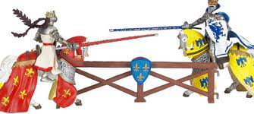
Unit 4 The Middle Ages @ 500-1500
Unit 4: Middle Ages
SSWH7 Analyze European medieval society with regard to culture, politics, society and economics.
Explain the manorial system and feudalism; include the status of peasants and feudal monarchies and the importance of Charlemagne.
D. Describe how increasing trade led to the growth of towns and cities

Slide 2
Think about it….
If our American government disappeared today, how would our lives be different tomorrow? Next month? Next year?

Slide 3
Part I
The Causes and Effects of the Middle Ages

Slide 4
What is it?
The Middle Ages: What is it?
Time period that existed between the Roman Empire and the Renaissance.
Lasts roughly 1000 years, 500-1500
Other names: The Dark Ages or medieval period.
Often seen as a very bleak and dangerous period

Slide 5
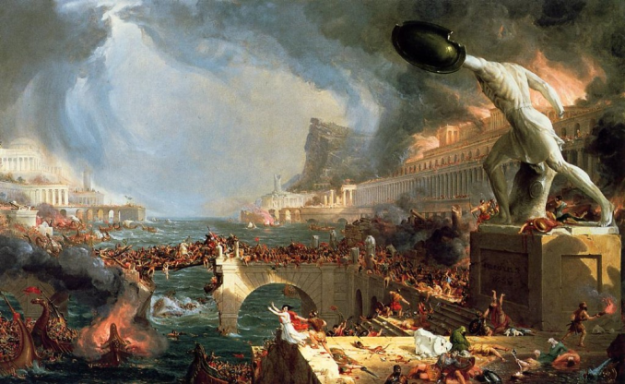
Causes of the Middle Ages
Fall of Rome
- was caused by invading Germanic tribes

Slide 6
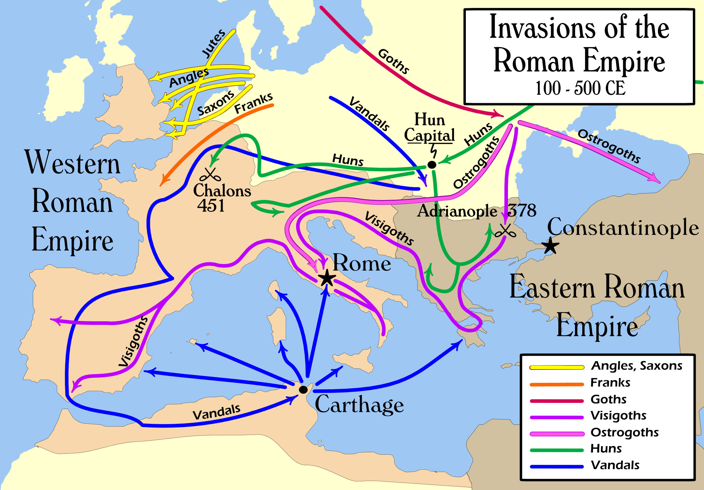
Causes of the Middle Ages
Invasions led to:
Disruption of Trade: Merchant trade collapsed and Europe’s economic centers were destroyed. Money also became scarce.
Downfall of cities: Cities were abandoned as centers of administration.

Slide 7
Causes/Effects of the Middle Ages
Europe became rural: Roman cities left without strong leadership
Decline of learning: Germanic invaders could not read or write. Learning became less important as people moved to rural areas.
Loss of a common language: Latin changed as Germanic people mixed with Roman population.
Loss of established government: Germanic tribes did not have written laws nor an orderly government for ruling purposes

Slide 8
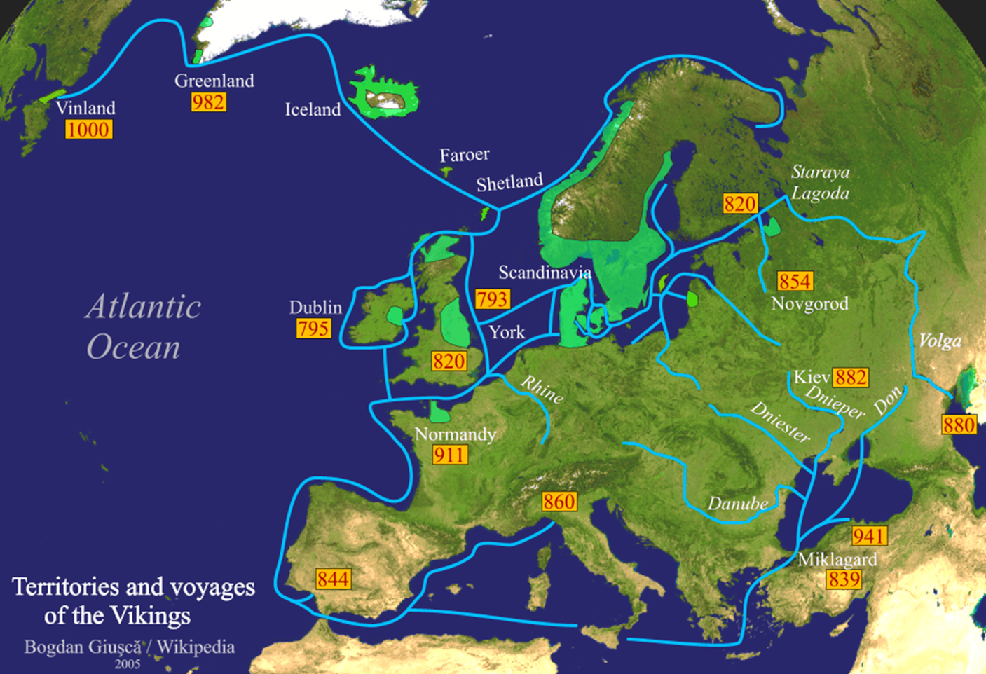
Spotlight on one invader: The Vikings!

Slide 9
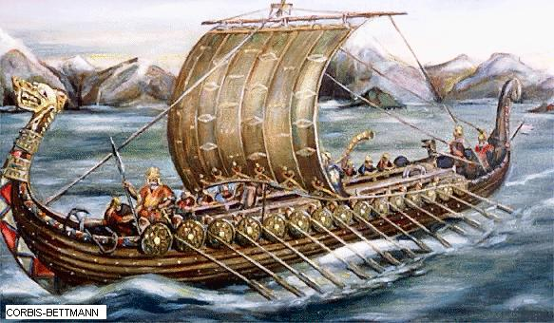
Vikings would raid in boats called “Drakkar.” They had a shallow draft for going into shallow bodies of water. If the water got too shallow, they would cut down trees & cart the boats over land. The boats were often fitted with dragon heads for “scare” tactics.
Drakkar

Slide 10
Accurate image of a Viking. Note the weapons and the lack of horns on the helmet
Early Hollywood gave their movie Vikings horns in order to make them more intimidating.

Slide 11
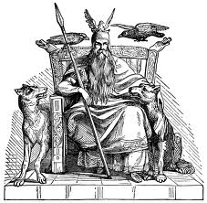
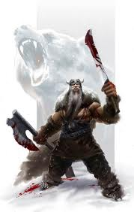
Viking Warriors
“berserkers seem to have been members of cults connected with Odin in his capacity as god of warriors.”
Odin – Norse mythoogy – god of War, Battle, Victory Death and Wisdom
“When the "berserker rage" was upon him, a berserker was thought of as a sort of "were-bear" (or werewolf), part man, part beast, who was neither fully human nor fully animal.”

Slide 12
Lindisfarne Abbey
Favorite place for Vikings to raid were abbeys, or churches. Monks were either killed or made slaves. Why did Vikings raid the churches?
They were not defended, had lots of grain in storage, and the bibles they created were usually elaborated decorated with gold and jewels.
Notes:
Viking’s liked to attack the abbey’s (churches) because they would face little resistence and often the bibles they were translating/rewriting were covered in gold and jewels.

Slide 13
The most famous find of Viking Raids - The Book of Kells
The Book of Kells is celebrated for its lavish decoration and survival of the Viking Era – Enjoy a few of the pages from this book
Notes:
The manuscript contains the four Gospels in Latin, written on vellum (prepared calfskin), around 561 by St Colum Cille on Iona, an island off the west coast of Scotland. In 806, following a Viking raid on the island which left 68 of the community dead, the Columban monks took refuge in a new monastery at Kells, County Meath. It must have been close to the year 800 that the Book of Kells was written, although there is no way of knowing if the book was produced wholly at Iona or at Kells, or partially at each location.

Slide 14
Image of Jesus
After the fall of Rome, learning practically disappeared. The Bible was spirited away to Ireland. Hand copies were made. The most famous was the Book of Kells.

Slide 15
Chi Rho
It was commissioned by St. Columba; created by two scribes and it took at least 30 years to create. It was covered in gold and incrusted with precious stones.

Slide 16
Book of John
The book was stolen and 1007 and found in a ditch months later – without its cover.

Slide 17
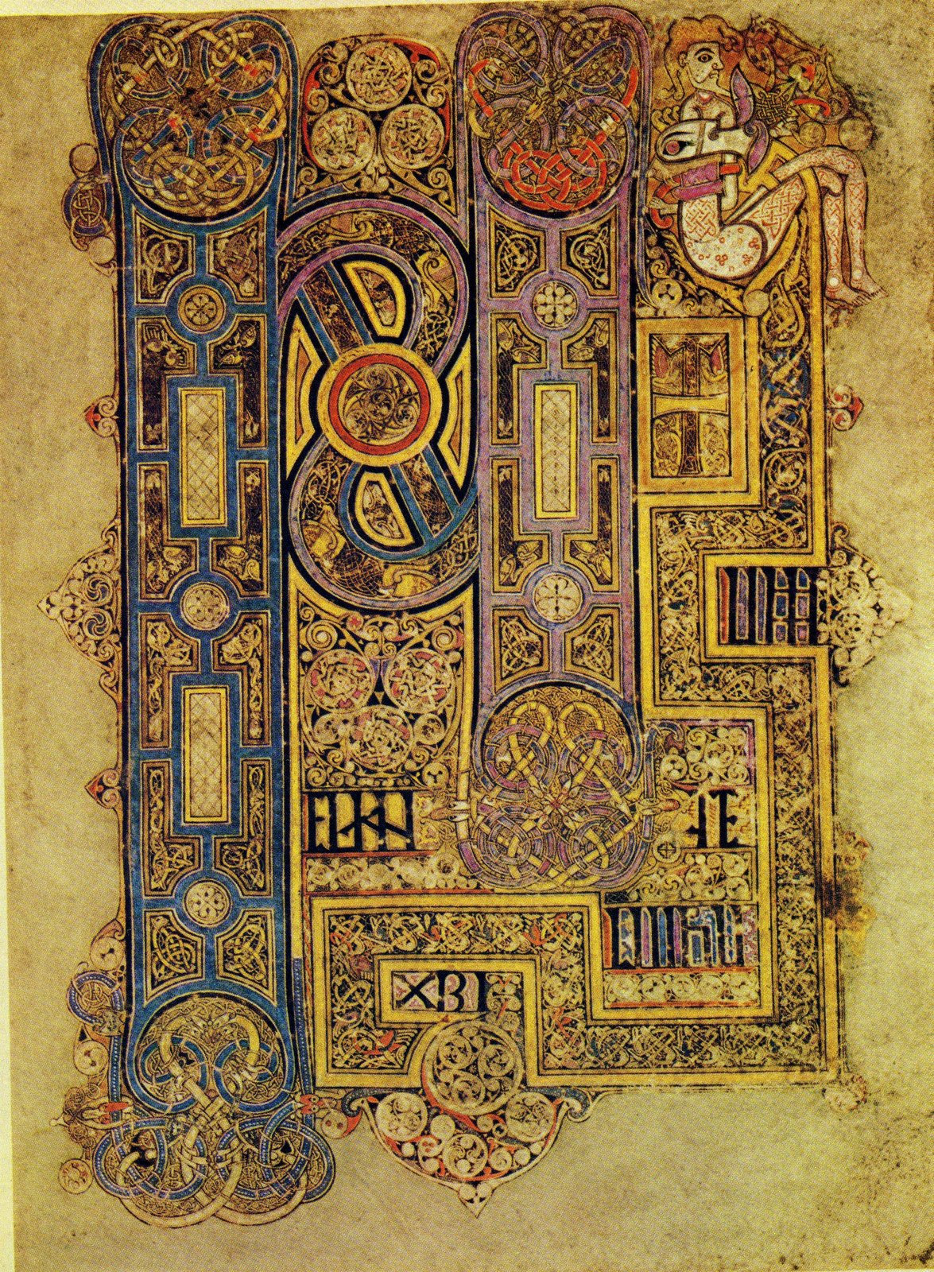
Book of Mark
The Book of Kells is now on display at Trinity College in Dublin

Slide 18
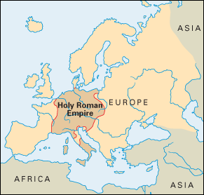
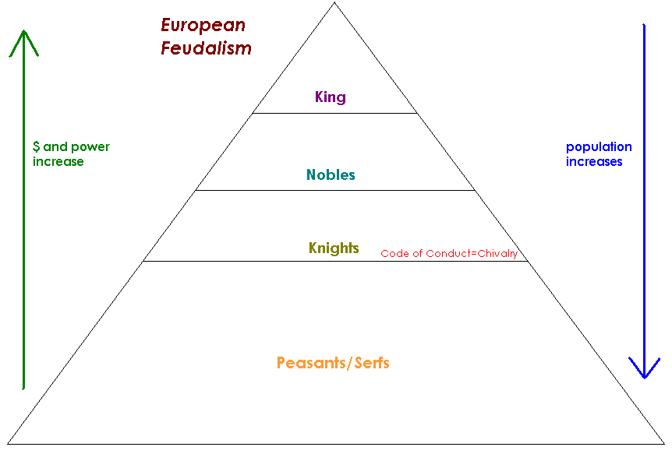
Effects of the Middle Ages
How did the Middle Ages Change Europe (Effects)?
New Germanic Kingdoms Emerge (Holy Roman Empire)
Rise of the feudal system in Europe

Slide 19
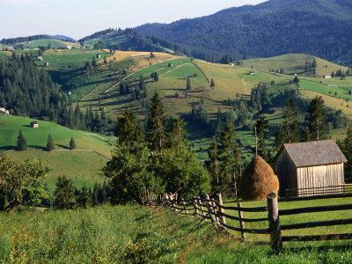
Effects of the Middle Ages
The power of the Christian (Catholic) Church grows rapidly
The power of the pope(s) grows rapidly
Europe became rural (safer inland?)
No major emphasis on learning
Only monks can read or write and the
only book they read or re-write is the
Bible.

Slide 20
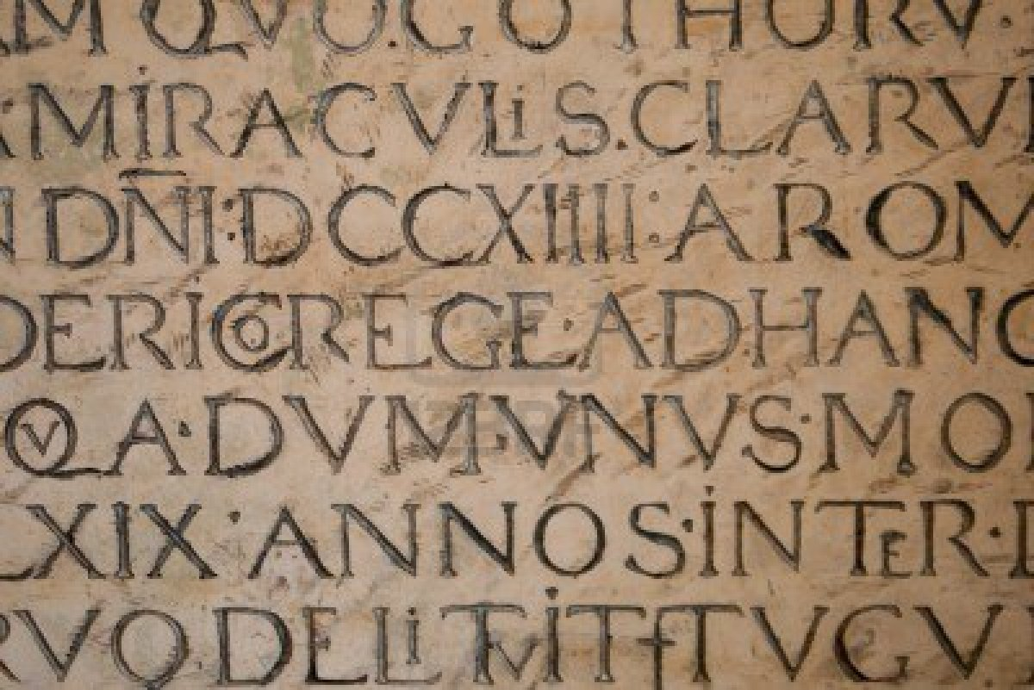
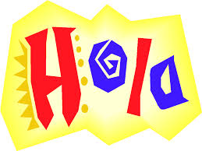
Effects of the Middle Ages
Effects of the Middle Ages
New languages replace Latin

Slide 21
Part II
The Germanic Kingdoms and CHARLEMAGNE

Slide 22
Germanic Kingdoms Emerge
Germanic Kingdoms
In the upheaval between 400 and 600, small Germanic kingdoms replaced Roman provinces
Borders changed constantly
Family ties and personal loyalty were more important than public government and written law
Germanic stress on personal ties made it impossible to establish orderly government

Slide 23
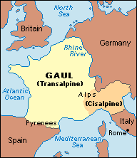
Germanic Kingdoms Emerge
Clovis and the Franks
The Franks had power in Gaul (modern day France and Switzerland)

Slide 24
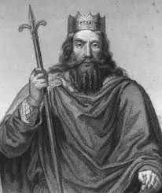
Germanic Kingdoms Emerge
Clovis was leader of the Franks
Christianity was a constant variable in the Middle Ages
Clovis brings Christianity to the region
Fears defeat by another Germanic tribe and appeals to Christian God:
Battle shifts in his favor and Franks win
Clovis and 3,000 of his warriors ask a bishop to baptize them
By 511, Clovis had united the Franks in one kingdom

Slide 25
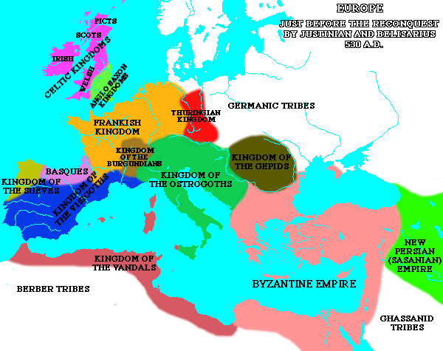
Germanic Kingdoms Emerge
A Frankish Empire Evolves
The Franks now controlled the largest and strongest of Europe’s kingdoms
When Clovis died in 511, the Franks controlled most of modern day France

Slide 26
Charlemagne

Slide 27
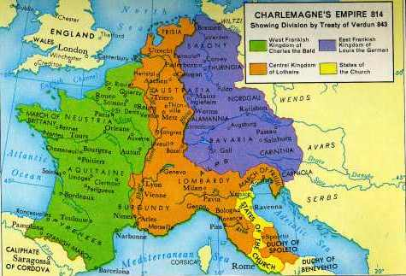
Charlemagne
4. Charlemagne Becomes Emperor
Pepin the short died in 768
Charles the Great, better known as Charlemagne takes over in 771
Imposing figure standing 6 foot 4 inches tall

Slide 28
Charlemagne
Charlemagne as King
Was now the most powerful king in Western Europe
Charlemagne built an empire greater than any known since the Romans
His conquests against the Muslims to the south and east spread Christianity
He united Western Europe for the first time since the Roman Empire
The empire became known as the Holy Roman Empire
Charlemagne strengthened his power by weakening power of the nobles
Sent out royal agents to check on powerful landowners
Regularly visited his kingdom
Encouraged learning- surrounded himself with scholars and opened new monasteries

Slide 29
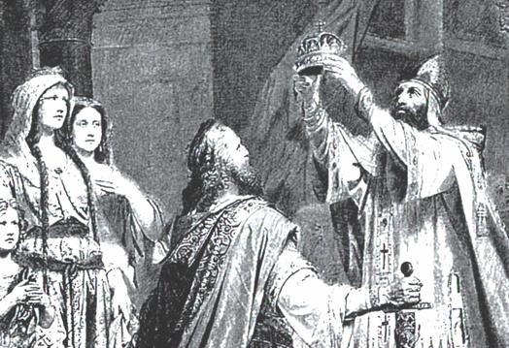
Germanic Kingdoms Emerge
In 800, he traveled to Rome to protect the pope → the pope rewards Charlemagne by crowning him emperor
This historic coronation showed that the pope had more power than the king

Slide 30
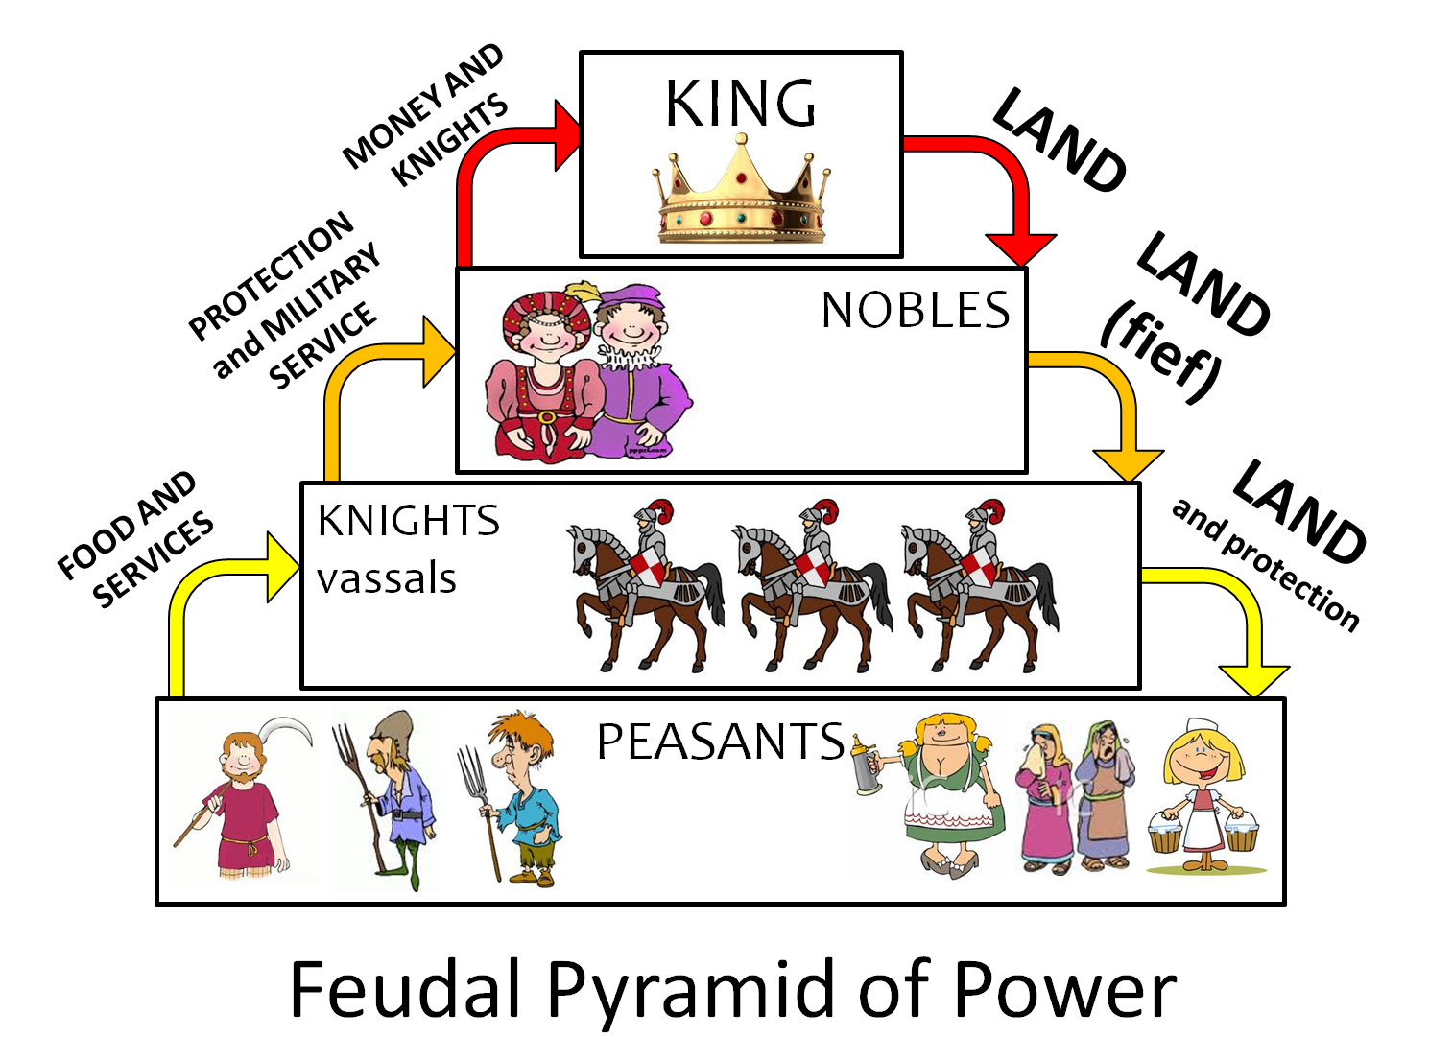
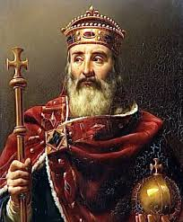
Germanic Kingdoms Emerge
g. Charlemagne died in 814, his grand sons split up the kingdom- bad idea
Carolingian kings lost power and authority broke down
h. This lead to the rise of feudalism

Slide 31
RESULT -
Helps lead to the rise of FEUDALISM

Slide 32
Back in England:
The SAXONS will find themselves fighting on two fronts 1) VIKINGS in the north and 2) WILLIAM the CONQUEROR in the south.

Slide 33
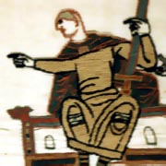
A. William the Conqueror
i. He is The Duke of Normandy (Viking descent)
ii. invaded England in 1066 and fought the Battle of Hastings
In exchange for loyalty he granted land to his followers
Created the Doomesday Book
– a census of England
Click for music video

Slide 34
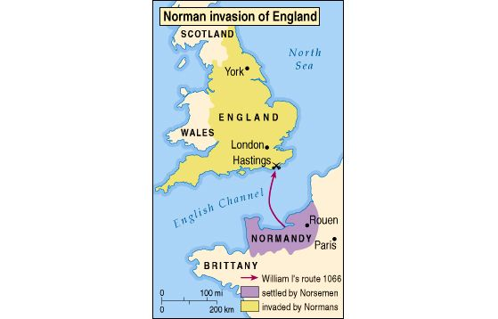

Slide 35
Bayeux Tapestry
The only record of the battle

Slide 36
6. Other Changes ----
Language…mix of Saxon and French creates ENGLISH!
Building styles change – instead of building with wood, now they build with stone
Churches change as well, from Dark blocky buildings with only arrow slits to churches with lots of windows, spires and ornate art.

Slide 37
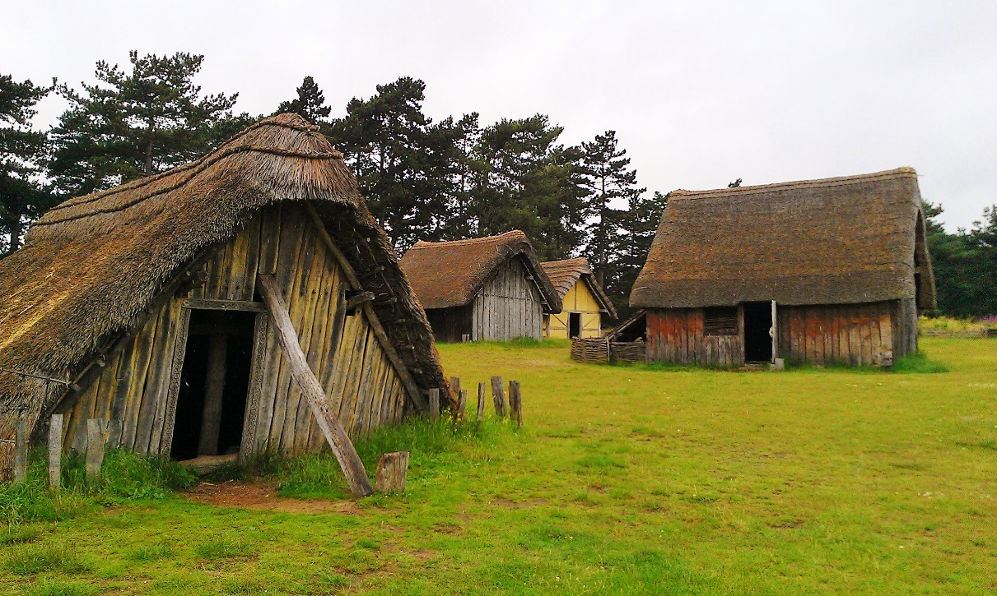
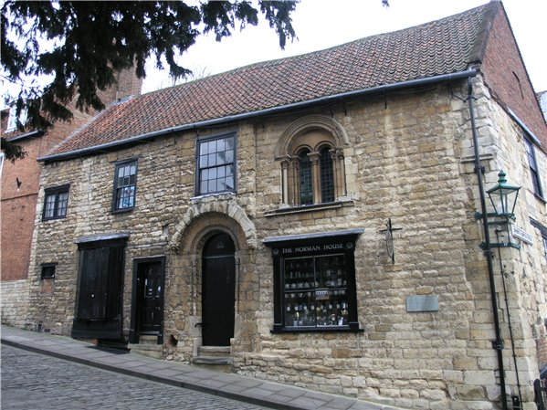
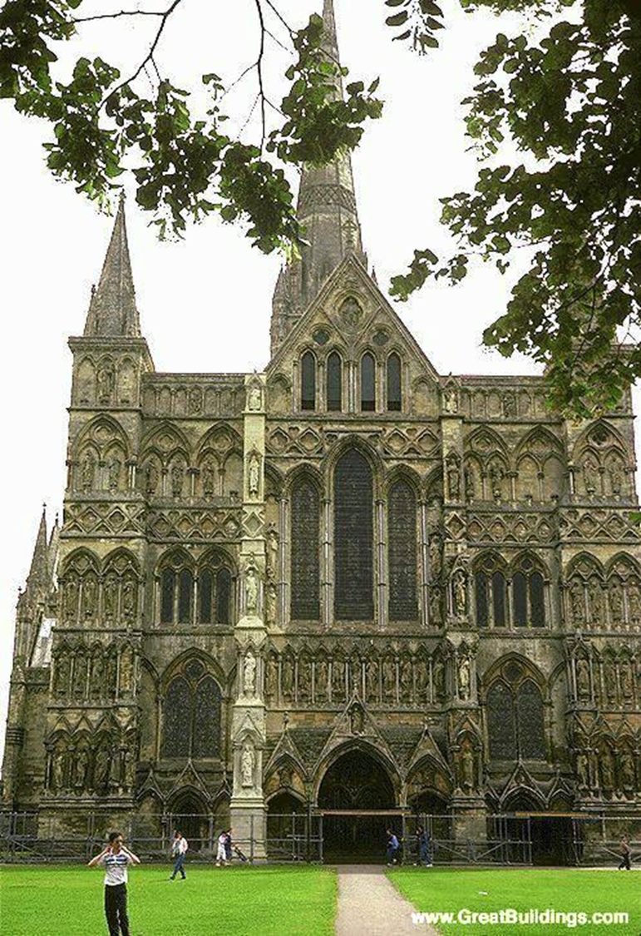
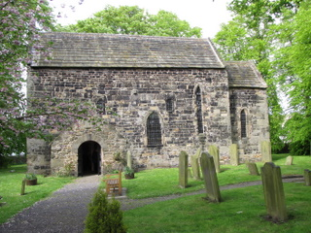
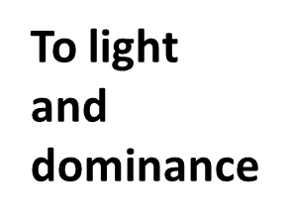
Norman Home from the 1100s
Saxon Huts
You go from safety……

Slide 38
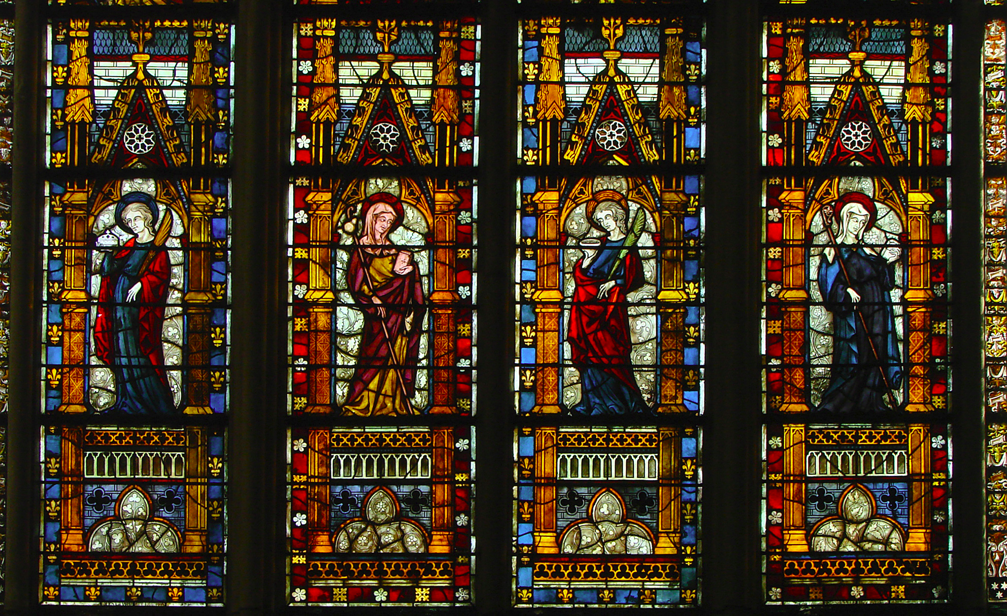
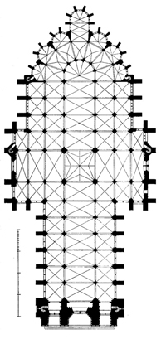
Inside….

Slide 39
7. Growth of Trade & Banking
Agriculture promotes changes in economics
Urban growth allows greater trade which in turn helps start banking
Banking began by Italian business people spread to the rest of Europe (using money)
Later – the church would determine that Christians shouldn’t handle money and b/c Jews weren’t allowed to have certain jobs; they became the money handlers.

Slide 40
Medieval Life

Slide 41
Growth of Towns & Cities
Two of the most important changes brought about by the Commercial Revolution were:
What people did for a living and 2) Where they lived.
As people moved to the towns, the towns turned into cities. What’s the difference between the two: Places are classified as towns or villages depending on the number of inhabitants and human settlements. Population began to increase and towns and cities flourished.
Trade was the driving force behind the growth; new towns developed at important “meeting” places like crossroads, rivers and hilltops. This was an exciting time – but with unprecedented growth came problems – animals, human waste and garbage which would be tossed out into the street in front of the house. Most people never bathed, and their houses lacked fresh air, light, and clean water. Because houses were built of wood with thatched roofs, they were a constant fire hazard. Nonetheless, many people chose to move to towns to pursue the economic and social opportunities they offered.

Slide 42
People were no longer content with their old feudal existence on manors or in tiny villages. Even though legally bound to their lord’s manor, many serfs ran away. According to custom, a serf could now become free by living within a town for a year and a day. A saying of the time went, “Town air makes you free.” Many of these run- away serfs, now free people, made better lives for themselves in towns.
A new MERCHANT CLASS developed, the merchants and craftspeople did not fit into the old medieval social order of noble, clergy and peasant. These people could now demand privileges and would later become the “middle class”

Slide 43
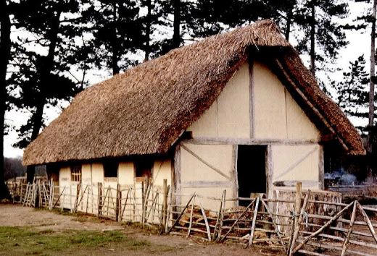
Villager’s Home

Slide 44
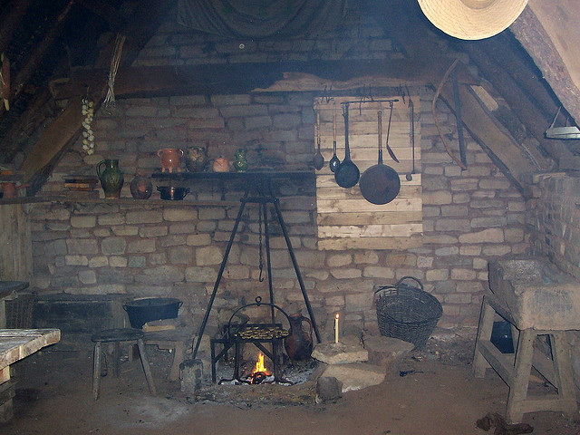
Inside…

Slide 45
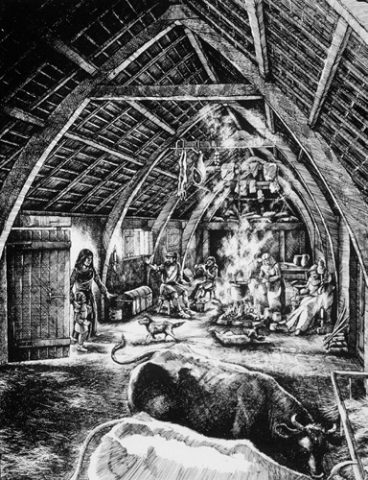
with the animals

Slide 46
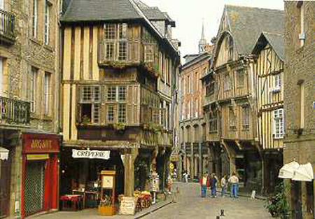
Living in “town”

Slide 47
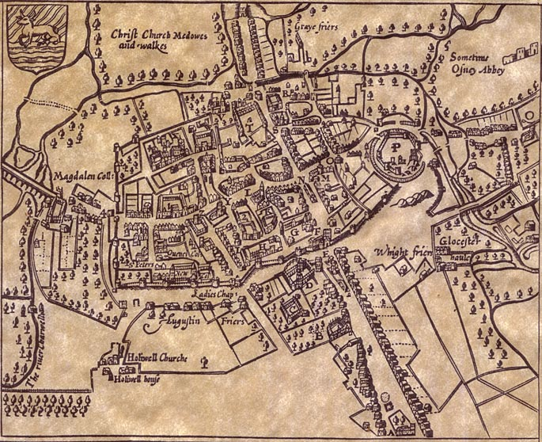
Example: OXFORD

Slide 48
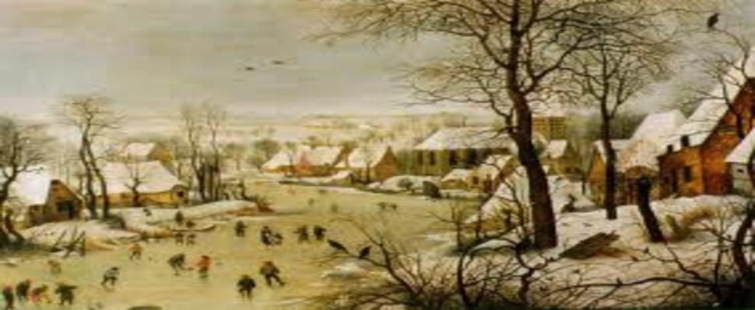
The 1300’s
Climate shift…Gods punishment?

Slide 49
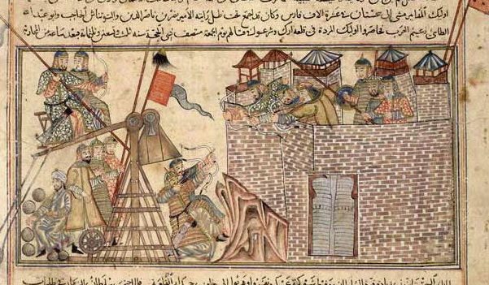
The 1300’s
Great Plague – begins in 1348
Mongols use first biological war weapons - Brought to Europe though trade ships; (people trying to flee the Mongols)

Slide 50
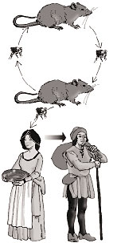
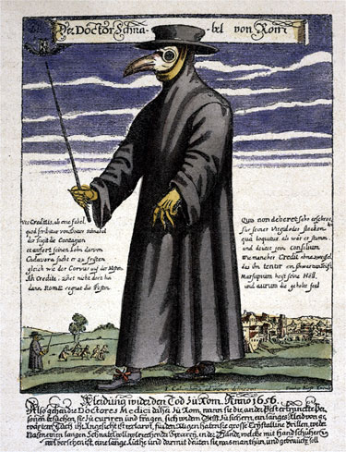
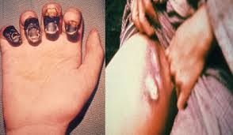
The 1300’s
Fleas on Rats (spread through air and fluid)
Video for plague

Slide 51
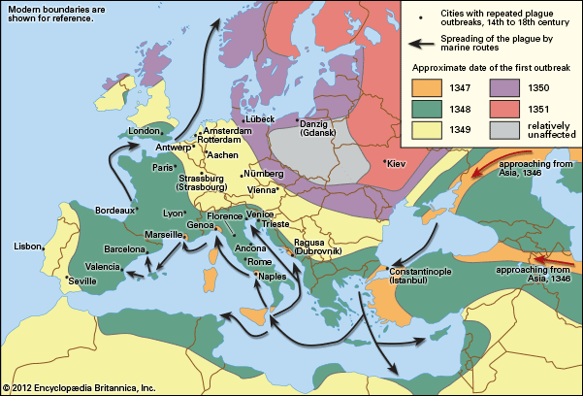
The 1300’s
Major population loss - 1/2 pop. of Europe died.

Slide 52
Dance of Death

