Slide 1
Exploration & Discovery

Slide 2
The GPS’s
WH10 Analyze the impact of the age of discovery and expansion into the Americas, Africa, and Asia
Explain the roles of explorers and conquistadors’ include Zheng He, Vasco da Gama, Christorpher Columbus, Ferdinand Magellan, James Cook, and Samuel de Champlain.
Define the Columbian Exchange and its global economic and cultural impact.
Explain the role of improved technology in European exploration; include the astrolabe.

Slide 3
The Beginning of Exploration
Exploration didn’t happen for Western Europe after 1430. Why? They didn’t have adequate navigation instruments, and they needed better ships.
It was through contacts with Arab merchants that these advancements were able to occur (By the way, the Arabs learned from the Chinese!)

Slide 4
Rumors spread about wealth in other lands, and Europeans were read to go search for trade routes to that wealth.
Their mantra became GOD, GLORY & GOLD.
They would not have been able to achieve as much as they did if it was not for the contacts with ARAB merchants.
The new technology included the ASTROLABE, the COMPASS and the CARAVEL with triangular sail shapes.
PORTUGAL starts it all for the Europeans. PRINCE HENRY of Portugal founds a school of navigation where sailors learn the art of the sea.
The Portuguese are the first to sail down the coast of Africa, reach Asia with a direct sea route to INDIA AND THE INDIAN OCEAN.

Slide 5
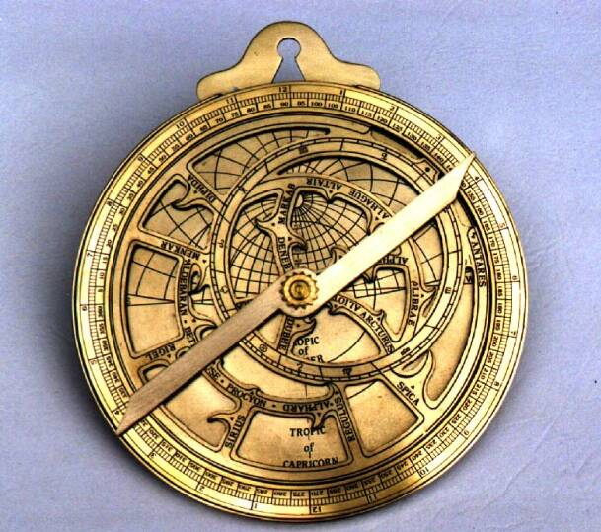
The Astrolabe

Slide 6
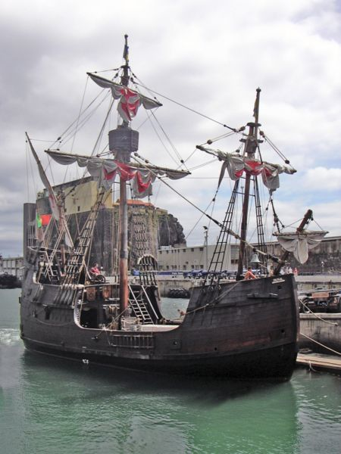
Caravel

Slide 7
Spain gets jealous, and through CHRISTOPHER COLUMBUS they begin exploration (looking for a route to asia. Instead, Columbus lands on the island of HISPANIOLA. This begins a rivalry between Spain & Portugal. It gets so bad, that the Pope steps in with a peace proposal. He draws a line N to S down the ATLANTIC Ocean. All lands WEST of that line belong to Spain. All lands EAST of that line belong to Portugal. This line is known as the LINE OF DEMARCATION. Portugal whined that Spain got to much, so the line was moved to include what is now modern day BRAZIL.
They sign off on the deal and this becomes the TREATY OF TORDESILLAS. And this is why that today, in BRAZIL they speak PORTUGUESE not Spanish like the rest of South America.
Now – Portugal becomes a very powerful trading group in Africa and India (in the Indian Ocean).

Slide 8
The Division of the Treaty

Slide 9
ZHENG HE
He was the son of a Chinese peasant who became one of the greatest admirals and explorers in the world.
He was Chinese, but was also a MUSLIM. He began his voyages in 1405.
A total of 7 voyages; and his fleet traveled the world. He brought back goods from all over the world. Many of the ruling class in China felt this was a waste of money
and stopped exploration by 1433.
China and Japan after short dealings with Europeans closed their doors to outsiders, and adopted a policy of ISOLATION.

Slide 10
How big were his ships?

Slide 11
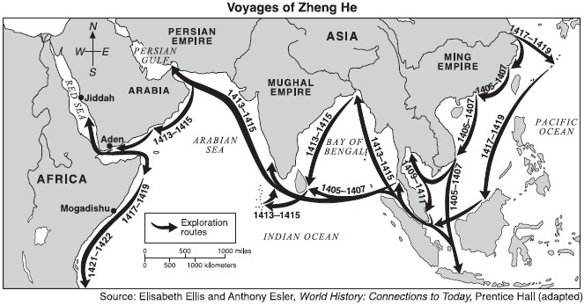
Where all did he go?

Slide 12
What did he look like?

Slide 13
The Atlantic World
After Columbus bumps into Hispaniola, Spain decides to colonize the area. Other explorers follow, they are called CONQUISTADORS . HERNAN CORTEZ lands on the shores of Mexico, and discovers the AZTECS. Because of an ancient legend of QUETZACOATL the Aztecs accept Cortes with open arms. He conquers the Aztecs because they have superior TECHNOLOGY and because they bring with them WEAPONS like GUNS & CANNONS.
FRANCISCO PIZARRO marched his men into Peru and conquered (destroyed) the Inca. Spain was busy building an empire – relationships were formed (the children of these were called MESTIZOS. The Spanish used the ENCOMIENDA system of control which is very close to SLAVERY. The Spanish push North using primarily PRIESTS to explore & settle.

Slide 14
Prior to the 1400s, slavery was COLORLESS. Slavery began because of the need of cheap laborers in the NEW WORLD. At first, the Spanish and Portuguese tried to use the native Americans as slave labor, but that didn’t work. Why? THEY HAD NO IMMUNITY TO EUROPEAN DISEASES.
Remember, there was slavery already in Africa. Many kings would enslave their enemies (if they weren’t Muslim). So what do you do with all the captives who aren’t Muslim? You sell them for gold.
Africans, as slaves, had several advantages over the native Americans. 1) had IMMUNITY to EUROPEAN DISEASES 2) good AGRICULTURALISTS and 3) didn’t know their way around the new land 4) harder to BLEND IN if they did escape. (skin color). This business would later become known as the ATLANTIC SLAVE TRADE.

Slide 15
Spain became the early leader in the slave business (slaves to the Americas & islands) followed by Portugal (slaves to Brazil). Much later, nearly by 1700 England came to dominate the slave trade in the Atlantic (primarily to the islands). Africans cooperated with this venture, wanting gold and guns, and would bring their captives to port cities for trade. Very few African kings spoke up against this travesty. The journey through the Atlantic was called TRIANGULAR TRADE and the MIDDLE PASSAGE was considered the worst part of the journey. Consequences of the slave trade: 1) MANY CULTURES DISAPPEARED 2) SOMETIMES WHOLE GENERATIONS WOULD BE LOST 3) FAMILIES COMPLETELY TORN APART OR DISAPPEARED 4) HISTORY WAS COMPLETELY LOST.

Slide 16
The Columbian Exchange, is a term used for the transfer of foods, plants and animals back and forth from the Americas to Western Europe. (PG 572)
Some of the most important items that came FROM the Americas were: CORN, POTATO, TOMATO, CACAO, TURKEY
Some of the most important items that came TO the Americas were: HORSE, GRAPES, PEACH, GRAINS, DISEASES
Because of all these new things to trade – CAPITALISM started to grow along with a type of business called JOINT STOCK COMPANIES. This is were everyone puts their money together to get a profit.
Overall now, nations can achieve a FAVORABLE OF TRADE and increase their wealth, trade increases and people are eating better and living longer. Also, nations now recognize themselves as an IDENTITY which produces monarchs who have the need to fuel their power through their colonies.

