Slide 1
Early Africa

Slide 2
b. Describe the development and decline of the Sudanic kingdoms (Ghana, Mali, Songhai); include the roles of Sundiata, and the pilgrimage of Mansa Musa to Mecca.

Slide 3
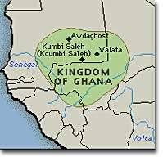
Ghana
The kingdom gained its wealth by taxing traders that traded in their territory
The Ghana kingdom developed its wealth through the salt and gold trade and tax
Islam would spread throughout the kingdom, Muslims would attack and leave the kingdom in ruins

Slide 4
Mali
Mali became established in the early 1200s after several kingdoms united into one after the fall of the Ghana Empire
The kingdom became wealthy through the gold and salt trade
Mali’s power began to decrease after succession to the throne was disrupted

Slide 5
Sundiata
The first leader of Mali
He established a strong and stable government including: military, economy, and foreign affairs
He made traveling through the kingdom safe and reestablished a strong salt/gold trade
He would die in 1255, it is unknown how he truly died
One story said he died by drowning in a local river, and another said he was accidently killed by an arrow during a festival

Slide 6
Sundiata is the true Lion King
His nickname is the “Lion King of Mali”
Yes, his story inspired the Walt Disney Film, “The Lion King”
He converted to Islam, but did not require his subjects to convert

Slide 7
Mansa Musa
Emperor of Mali who made a pilgrimage to Mecca
Gave out massive amounts of gold during his pilgrimage to Mecca
Returned with Muslim architects and scholars who would build libraries, mosques, and universities
Timbuktu became the center of Muslim culture

Slide 8
King of Kings
Mansa Musa means “King of Kings”
During his pilgrimage he took over 60,000 men with him, each one carrying bags of gold
He also took 80 camels with him, each camel carried around 300 pounds of gold
He is ranked as the richest person in history with a personal net worth of $400 billion

Slide 9
Songhai
Songhai was the Largest and last West African Empire
Conquered territories from the Mali Empire, eventually replacing it
Well governed empire with a massive military
The Songhai Empire collapsed after Moroccan forces invaded the empire with gunpowder and cannons, defeating the Songhai warriors

Slide 10
e. Analyze the role of geography and the distribution of resources played in the development of trans-Saharan trading networks.

Slide 11
African Geography
Africa is the second largest continent
Africa stretches for almost five thousand miles
Africa has four climate zones

Slide 12
African Climate Zones
Africa has a mild zone across the northern coast and at the southern tip
Deserts in the north, the Sahara, and the south, Kalahari
Along the equator is a rain forest
Savannas, broad grasslands, that stretches from both the north and the south of the rain forest

Slide 13
Distribution of Resources
Gold was mined in the western part of the Sahara
Traders would bring salt from the Sahara and manufactured products from both Europe and Arab countries in order to trade for gold

Slide 14
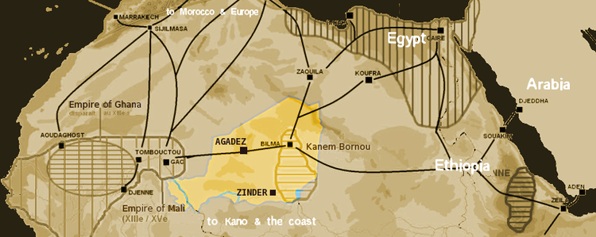
Trans-Saharan Trade
The trading of goods between Sub-Saharan Africa to the northern Arab and European countries
Used camel caravans to transport goods

