Slide 1
CHARTS AND GRAPHS
on the EOC, you will see several charts, graphs, and cartoons… lets talk through the How To ☺

Slide 2
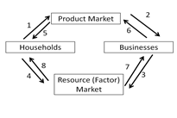
Arrows 4 and 7 on this circular flow diagram demonstrate:
a. Prices
b. Taxes
c. Money flow
d. Goods and services

Slide 3
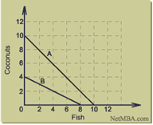
Based on the PPF, which is true about countries A and B? A. Country A has fewer resources to make fish, but more resources to make coconuts B. Country B has fewer resources to make fish, but more resources to make coconuts C. Country B has more resources in general D. Country A has more resources in general.

Slide 4
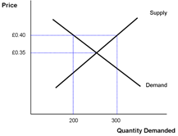
In the picture below, a price of .40 represents which situation?
A. A surplus because the price is below equilibrium.
B. A shortage because the price is below equilibrium.
C. shortage because the price is above equilibrium
D. A surplus because the price is above equilibrium.

Slide 5
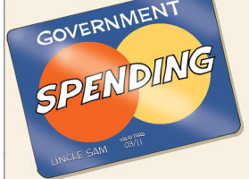
The cartoon above depicts which of the following ideas?
The US Government spending is not important to the rest of the economy
The US Government is in debt and has to borrow money in order continue operations
The US Government owns MasterCard corporation
The US Government has a budget surplus therefore can spend endlessly.

Slide 6
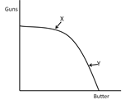
Which statement is true about this production possibilities curve?
A. Moving from point X to point Y incurs and opportunity cost of butter.
B. Moving from point X to point Y incurs an opportunity cost of guns.
C. At point X, this country is producing more butter than guns.
D. This country does not have to give up any guns to produce more butter.

Slide 7
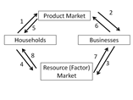
Arrows 1 and 2 on this circular flow diagram represent
taxes
prices
money flow
goods and services flow

Slide 8
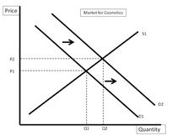
What can be inferred from the graph above?
A. The increase in supply has caused an increase in equilibrium quantity.
B. Demand has increased, causing an increase in equilibrium quantity.
C. Supply has decreased, causing an increase in equilibrium price.
D. An increase in demand has caused a decrease in equilibrium price.

Slide 9
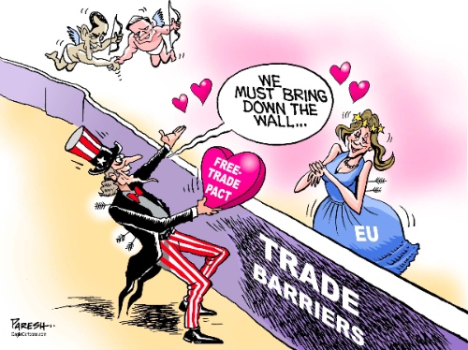
What concept is being depicted above?
Protectionism
Exchange Rates
Internationalism
Diversification

Slide 10
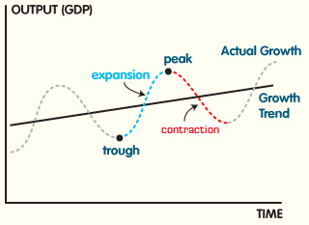
C
B
D
A
When the Fed implements a policy in which the interest rates are lowered, where is the US economy on the business cycle?
Point A
Point B
Point C
Point D

Slide 11
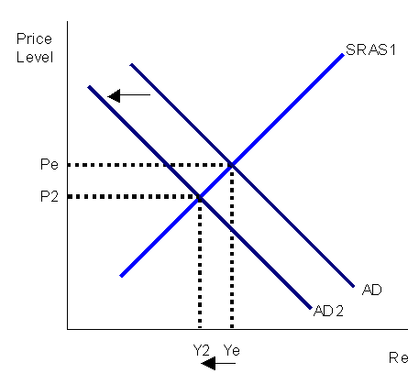
What would cause the shift seen above?
Consumers are concerned about the future and decide to postpone purchases
Businesses are excited about the future and increase investment
The cost to produce goods has increased due to government regulation
Technology has advanced exponentially and productivity increases.

Slide 12
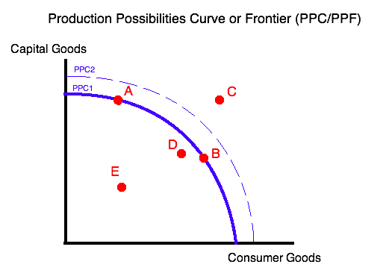
What is true about point E?
There are not enough resources available to produce at this point.
In order to produce at E, the nation must give up units of consumer goods in order to gain capital goods.
The nation is operating at its maximum potential with the given resources.
The nation is not operating efficiently and wasting the scarce resources.

Slide 13
Which arrows on the diagram above would represent the transaction between Joe who rents his office to Homework Inc., a company that provides tutoring services?
5, 6
4, 7
1, 2
2, 3

Slide 14
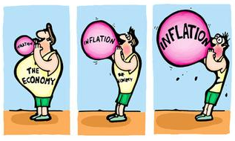
How does inflation affect the purchasing power of money and impact the economy?
Purchasing power of money | Impact on economy
Decreases | Negative
Increases | Positive
Increases | Negative
Decreases | Positive

