Slide 1
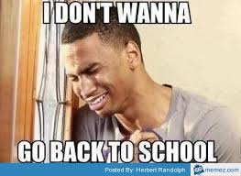
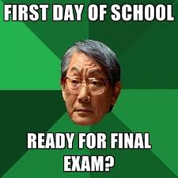
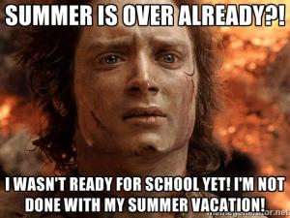
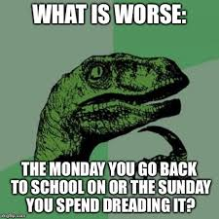
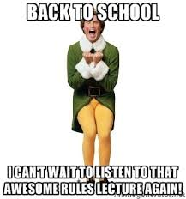
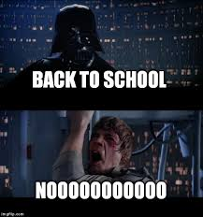
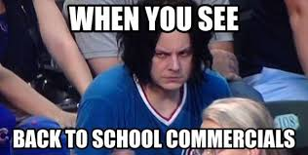
Welcome Back!
Enjoy these memes while we wait for everyone to get settled…

Slide 2
Are you in the right place?
I’m your teacher – Ms. Cheatham
IF IT IS 1ST, 2ND OR 3RD PERIODS – YOU ARE IN WORLD HISTORY.
IF IT IS 5TH OR 6TH PERIODS – YOU ARE IN ECONOMICS.
IF IT IS 7TH PERIOD – YOU ARE ON THE ACADEMIC DECATHLON TEAM.
We are in room 415
I teach World History, Economics and Academic Decathlon
I will be staying after school for student help on Tuesdays & Thursdays.
We have a website – it’s cheathamsworld.weebly.com

Slide 3
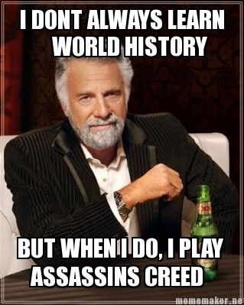
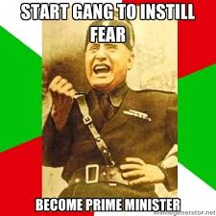
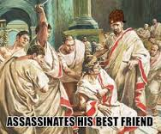
COURSE DESCRIPTION for WORLD HISTORY:
The World History course provides students with a comprehensive, intensive study of major events and themes in world history. Students begin with a study of the earliest civilizations worldwide and continue as students examine major developments and themes in all regions of the world. The course culminates in a study of change and continuity, and globalization at the beginning of the 21st century.

Slide 4
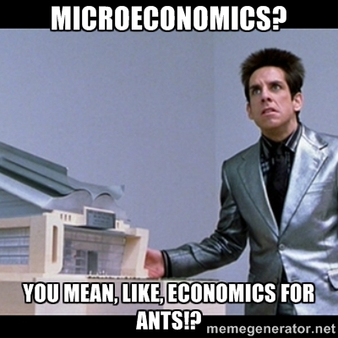
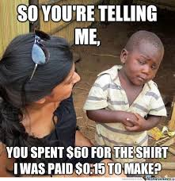
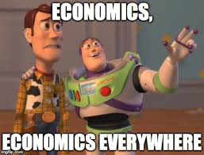
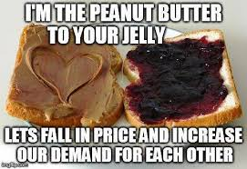
COURSE DESCRIPTION for ECONOMICS:
Economics is required for a high school diploma in the state of Georgia and provides students with a basic foundation in the field of economics. The course is designed to engage students in basic economic concepts revolving around 5 areas of study to include fundamentals, microeconomics, macroeconomics, international trade, and personal finance. In each area, students are introduced to major concepts and themes concerning that aspect of economics.

Slide 5
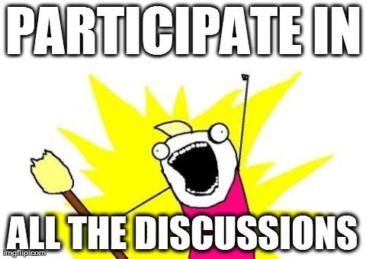
CLASS PARTICIPATION
All students are expected to participate in class discussions and activities. We will work together to ensure that by the end of the course students are well prepared to discuss all the units covered and material learned during the course.

Slide 6
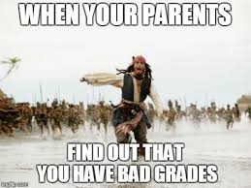
GRADING for World History!
The student is responsible for keeping their parents
informed on the issue of grades, although the
teacher will communicate overall grade concerns
with the parents. Grades can be viewed at Muscogee County’s Infinite Campus Parent Portal web site. https://campus.muscogee.k12.ga.us/campus/portal/muscogee.jsp
90 or above = A The percentages will be calculated as such:
80-89 = B Summative Assessments (Unit Exams): 40% Classwork: 10%
70-79 = C Formative Assessments (Quizzes): 20% Homework: 10%
69 and below = F Projects/Writing Assignments: 20%

Slide 7
GRADING for ECONOMICS!
The student is responsible for keeping their parents
informed on the issue of grades, although the
teacher will communicate overall grade concerns
with the parents. Grades can be viewed at Muscogee County’s Infinite Campus Parent Portal web site. https://campus.muscogee.k12.ga.us/campus/portal/muscogee.jsp
90 or above = A The percentages will be calculated as such:
80-89 = B Summative Assessments (Unit Exams): 60%
70-79 = C Formative Assessments (Quizzes): 30%
69 and below = F Other Assignments: 10%

Slide 8
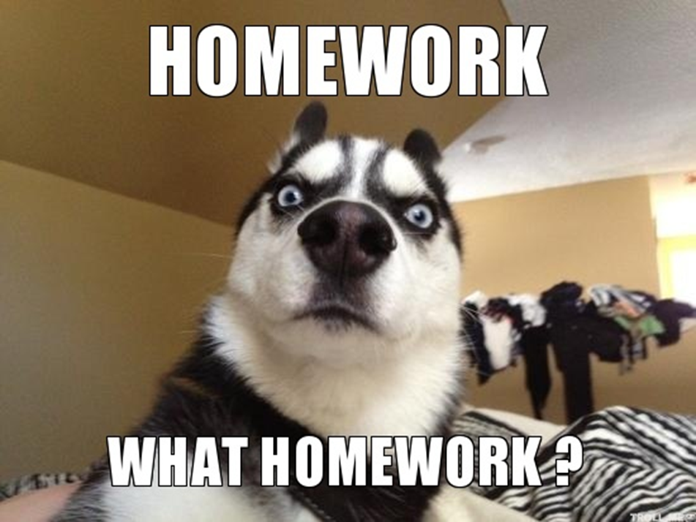
HOMEWORK
Homework is designed to reinforce given concepts for the student at Home. Not following through on homework nullifies the basic purpose of homework.

Slide 9
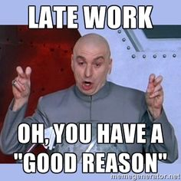
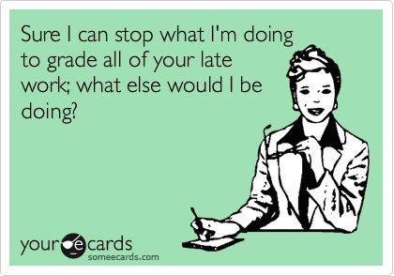
MAKE UP AND LATEWORK
According to Muscogee County School District’s policy, make up work shall be turned in three days from an excused absence. Late work may be turned in with a 20% grade deduction. No work will be accepted after Progress Report and Report Card cut off dates. However, early work will be accepted with a 10% addition to the grade.

Slide 10
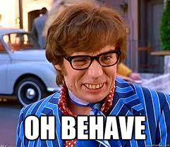
BEHAVIORAL EXPECTATIONS
All classroom policies are consistent with the Student Handbook issued at the beginning of each year. Failure to comply will result in one or more of the following:
1. Verbal Warning
2. Detention
3. Parental Contact letter, email, phone call, face to face. Contact will be documented in Infinite Campus.
4. Conference: teacher(s), student, parent, or teacher(s),
student, parent, counselor, administrator
5. Administrative Referral

Slide 11
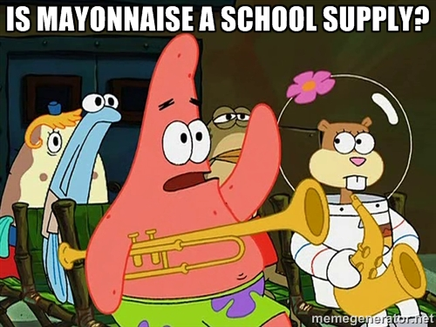
REQUIRED MATERIALS
Students will need the following every day.
Textbook
Writing utensils: pencils, highlighter, pens
Loose leaf paper in a 3-ring binder
Flash Drive & active email address

Slide 12
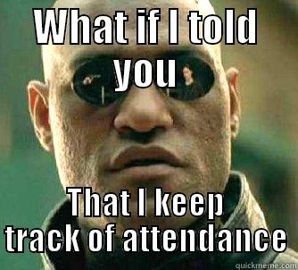
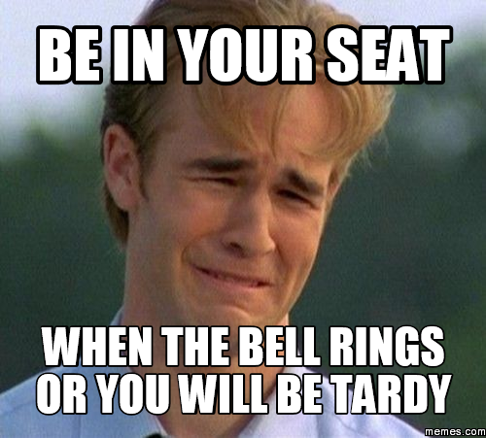
MANAGEMENT EXPECTATIONS
Attendance: Absenteeism greatly impacts your academic standing–it is hard to catch up if you miss more than a day. You are only allowed to be absent up to 7 days. After 7 absences you have earned “Loss of Credit,” or failure of the course. If you are absent you must present a valid written excuse to the front office within 3 days of your absence
Tardy: Simple: DO NOT BE LATE TO CLASS. Your whole body must be completely and physically in your assigned seat, in the classroom, before the bell rings or detention will result. No excuses. First block will be sent to the office for a pass otherwise all other blocks will receive tardy slips which will then culminate into a Friday school or Saturday School notice. Don’t be tardy.

Slide 13
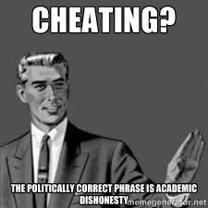
ACADEMIC HONESTY
Each student is to maintain the highest level of integrity. When it comes to assignments of any nature, you are expected to do his/her own individual work. Consequences will be applied to those who feel they don’t need to carry their own academic weight.

Slide 14
Ms. Cheatham’s Class Rules

Slide 15
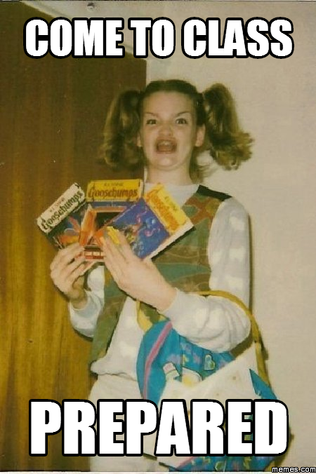
1. Come to class prepared, ready to learn and with an open mind. Do not question any assignments given; I do not give “busy work,” although you will have a lot of work.

Slide 16
2. Students must be seated in their assigned seats by the time the bell rings. Come into class quietly, sit down and complete your Do Now; do not stand at the door with me; this is something I am required to do. I will answer any questions you may have regarding assignments, etc. after I have taken roll. If you have to go to the restroom, do it before coming to class or wait the required fifteen minutes, then ask if you may go.

Slide 17
3. Students will be dismissed by the teacher; not the bell. Sometimes we haven’t finished the lesson; wait until I say you may go…

Slide 18
4. Chewing/bubble gum is not to be seen or heard. If I see it; I will tell you to put it in the trashcan – do not balk; just do it

Slide 19
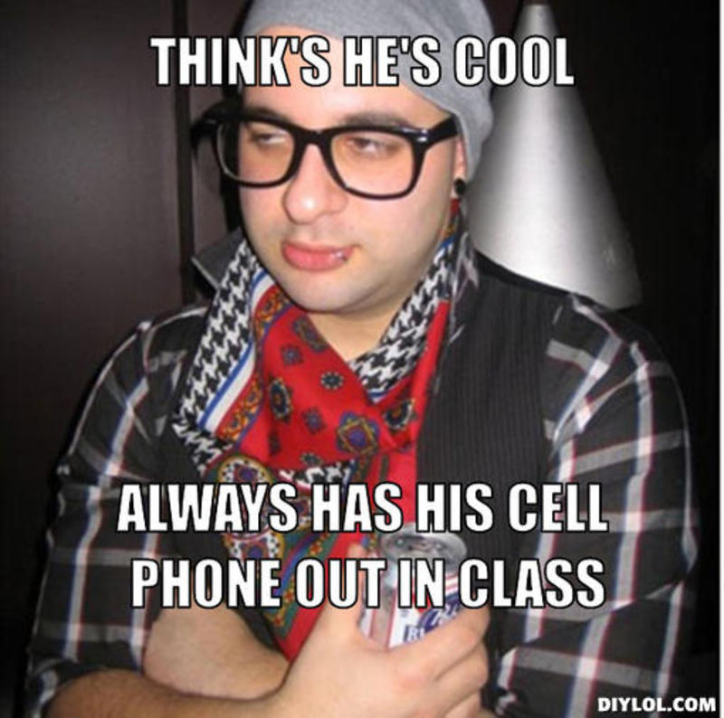
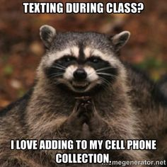
5. Cell phones may be out on your desk FACE DOWN or in a pocket, purse or bag-but are not to be used during class unless I have given you permission. Ok-using cell phones in class has become an art form. Your parents don’t send you to school every day to run up your data. We can work this out together with cooperation.

Slide 20
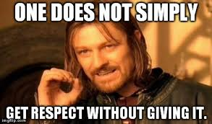
6. Respect goes both ways Really – your past does not follow you in this classroom; you will make your own way. Whatever you have heard about me or this class; forget it. Each class creates its own personality and therefore, it is going to be a good semester or not based on you and your classmates.

Slide 21
Ms. Cheatham’s Guidelines

Slide 22
Bathroom breaks are a privilege – not an adventure. Go and come straight back. You must have you passbook in order to leave the room.

Slide 23
Grooming should be kept private and not public – hair, lotion, etc.

Slide 24
When absent – place your excuse in the CENTER of my desk – I will sign and return it

Slide 25
Do not leave trash lying around – this is my home 8 -10 hours/day. Plus we have ants-mean ones.

Slide 26
Discipline Detention and/or parental contact can be earned for classroom infractions

Slide 27
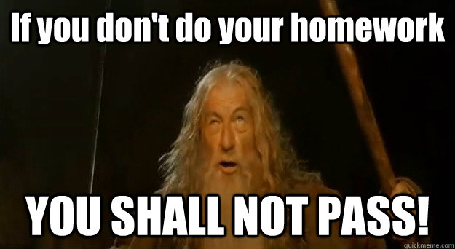
Academic Detention and/or parental contact can be earned for failing grades, lack of classwork or homework completion

Slide 28
Do not remove anything from my area without asking; it’s just the right thing to do.

Slide 29
BTW – don’t skip this class.

