Slide 1
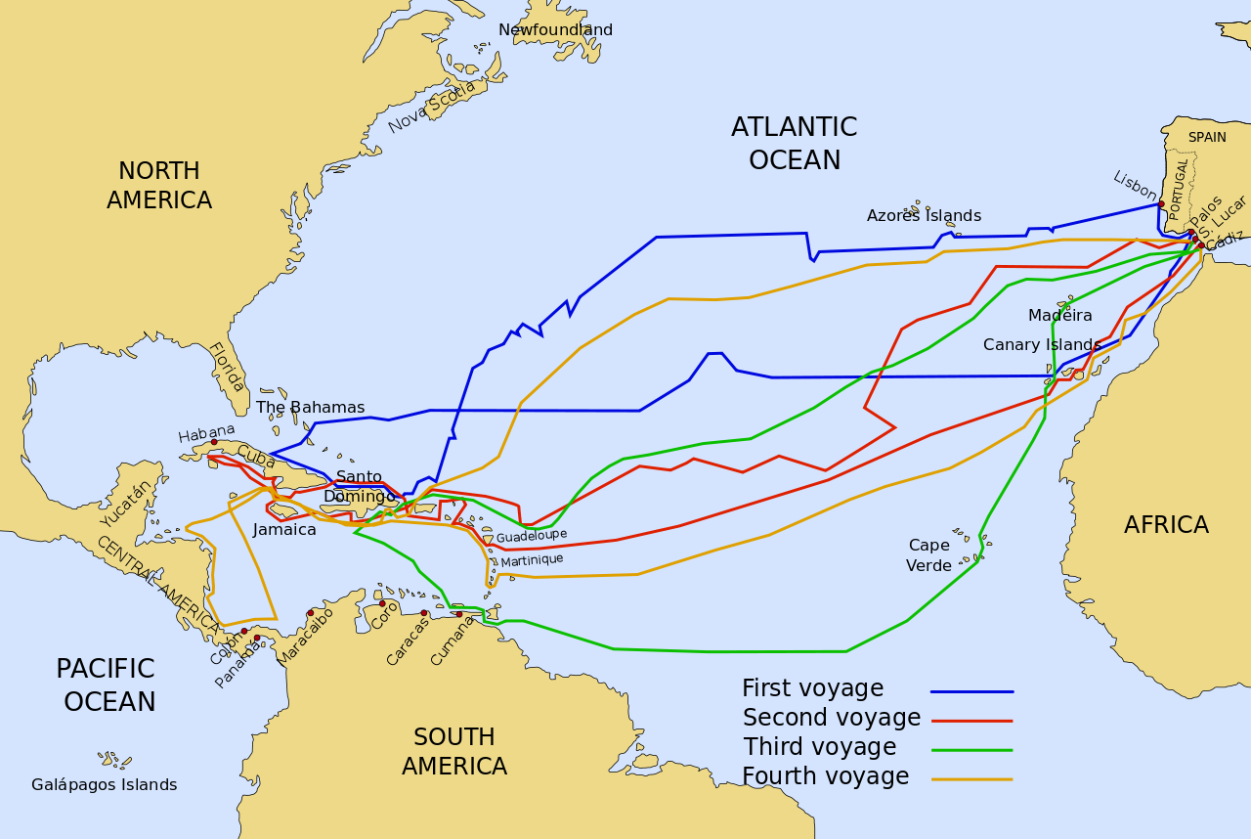
Do Now for MOnday, November 28
Look at this map.
How many trips did Columbus make?
Did he ever land in North America?
Where does he start from on his 1st voyage?

Slide 2
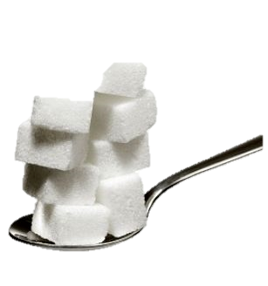
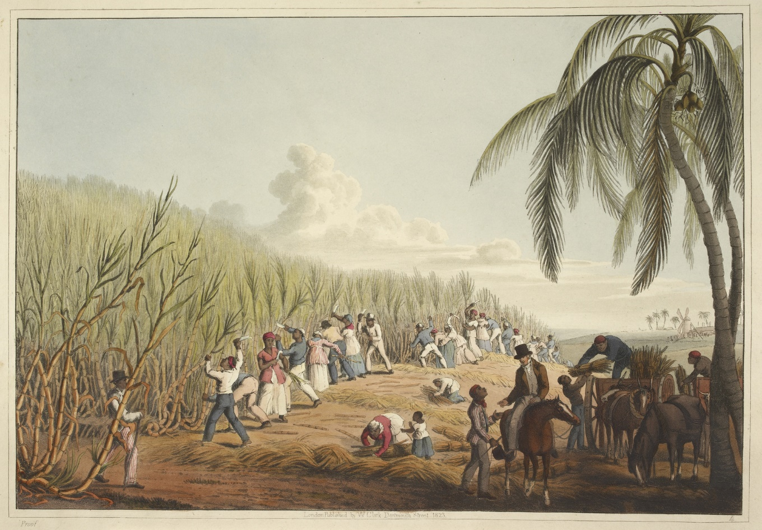
Do Now for Tuesday, November 29
How would sugar change the world?
Why would the English drive the trade behind sugar?
How would have the sugar trade impact millions of people?

