Slide 1
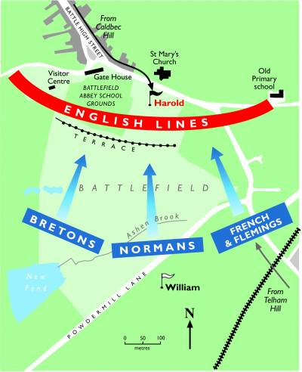
Do Now for Tuesday, October 18
Are you smarter than a 5th grader in geography?
Use the map to the right to answer the following questions. You do not have to write the questions.
Using what you learned last week, this is probably a map of the ________
How many groups are fighting against the English?
According to this map, was the battle fought on flat ground, on hills, the woods or in a city?

Slide 2
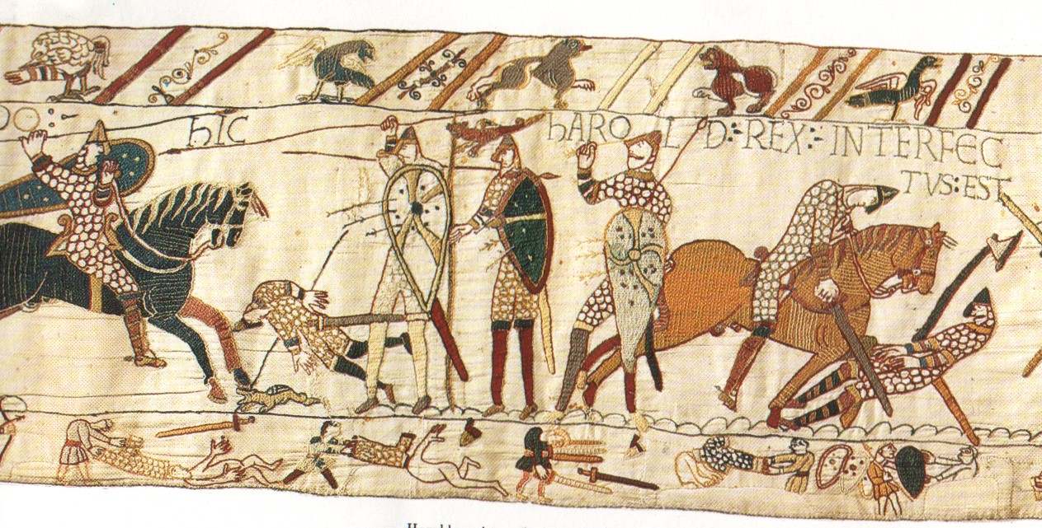
Do Now for Humpday, October 19
This is an image of the Bayeax Tapestry – remember how Harold dies at the Battle of Hastings?
Study the image to answer the following questions. You do not have to write the questions.
Find
Harold. How do you know it’s him?

Slide 3
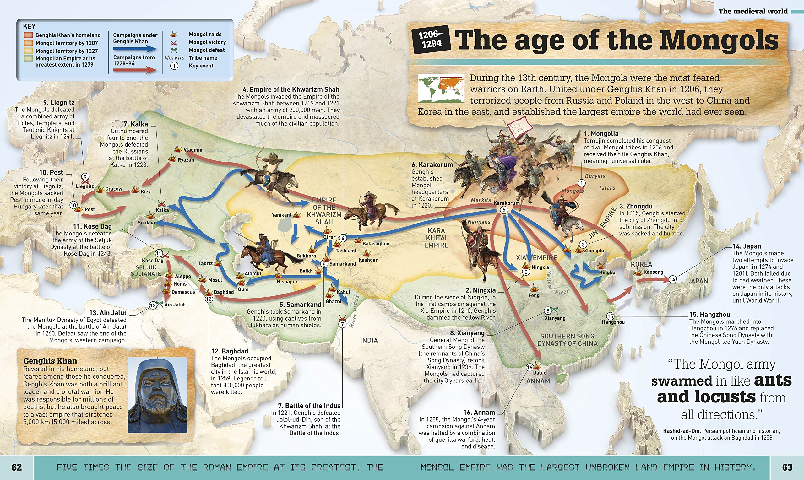
Do Now for Thursday, October 20
This is an image of the geography of the Mongols. Study the image and answer the questions. You don’t have to write the questions.
Where do the Mongols originate from?
What years are considered “the age of the Mongols?”
Who was Genghis Khan?

Slide 4
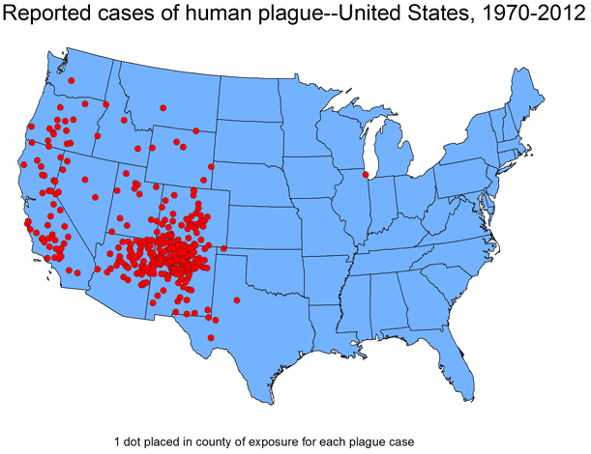
Do Now for TGIFday, October 21
This is an image of the geography of the modern plague. Study the image and answer the questions. You don’t have to write the questions.
Geographically, in what part of the US can the plague be found.
The highest area of concentration is in the four corners. List those four states.
See that lone dot in the mid-west US-what state is that?

