Slide 1
November 14, 2016
The Aztecs used what kind of knife in their sacrifices?
A. Steel
B. Wooden
C. Obsidian
D. Iron

Slide 2
November 15, 2016
Which Mesoamerica culture was the largest empire in the pre-Columbian America?
A. Inca
B. Aztec
C. Olmec
D. Mayan

Slide 3
November 16, 2016
Which country was the first to recognize the United States as a country?
A. France
B. Israel
C. England
D. Morocco

Slide 4
November 17, 2016
The Nile River is located in what continent?
A. Europe
B. Africa
C. South America
D. Asia

Slide 5
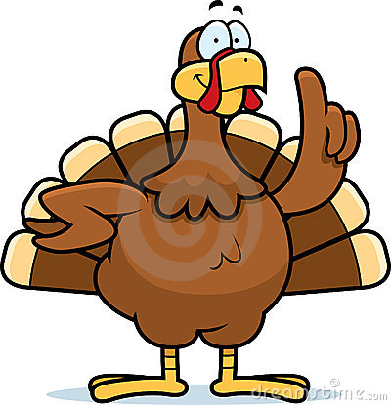
November 18, 2016
Pull out your notes and study for your African quiz.

