Slide 1
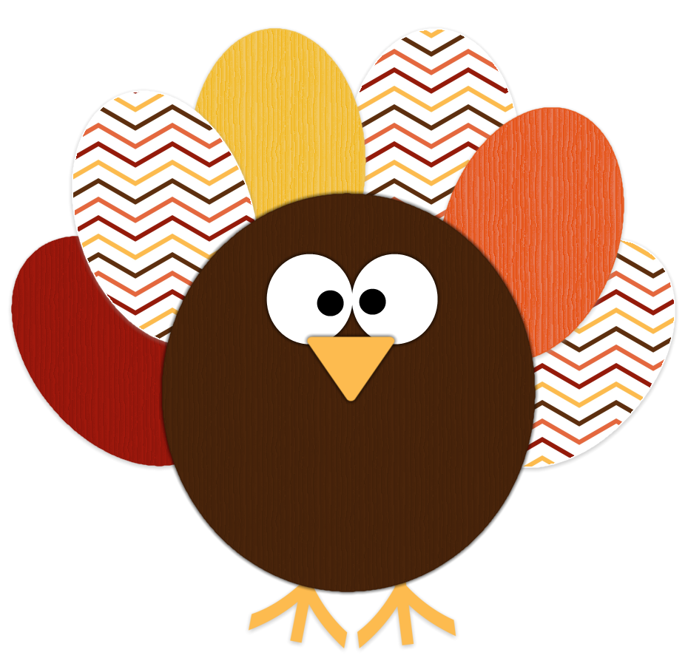
Do Now for MOnday, November 7
Thanks for being good while I was out. Were you?
I’m going to pass back out your substitute work.
make sure it’s all finished.
Make sure it’s stapled in order.
Turn it in to the right box.
You have MAYBE 10 minutes to get this done.

Slide 2
Do Now for Tuesday, November 8
You have a test today! How exciting!
Can you answer these questions?
Machiavelli believed ……
Johann Gutenburg invented the …
This invention increased the rise of literacy….

Slide 3
Do Now for HUMPday, November 9
Have you ever heard of the Maya?
Of the following, which do you think they invented?
The ZERO
Early form of basketball
Baseball
Inches

Slide 4
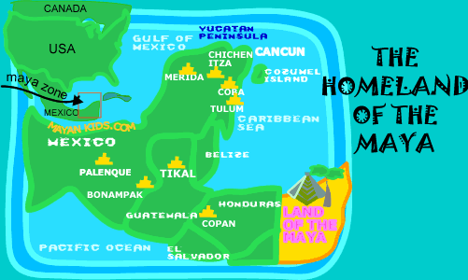
Do Now for Thursday, November 10
Can you list any of these countries?

