Slide 1
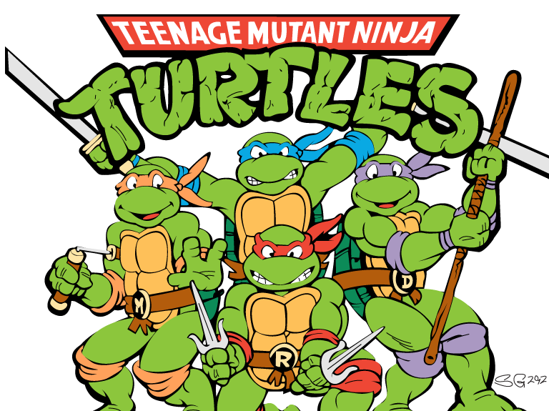
Do Now for Monday, October 24
You don’t have to write the questions.
Do you recognize this? Who are they?
List all four names.
What do they have to do with what your learning?
Do they have anything to do with the Renaissance?

Slide 2
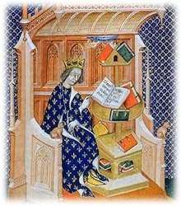
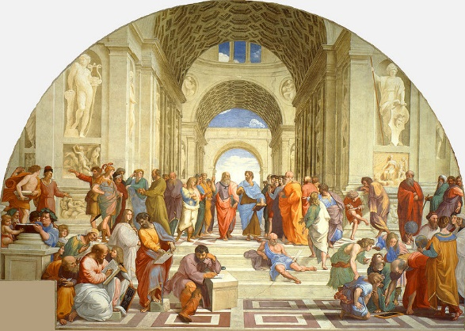
Do Now for Tuesday, October 25
You don’t have to write the questions.
Study the two works of art.. Which one is from the middle Ages?
2. Why do they look so different?

Slide 3
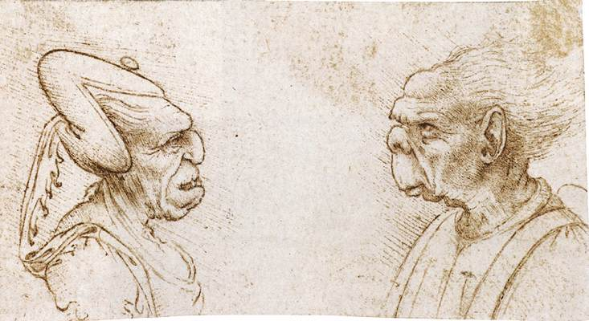
Do Now for HUMPday, October 26
You don’t have to write the questions.
This is called a “grotesque” drawn by Leonardo da Vinci
Why do you think
these are famous?
3. Why do you think
they are called
“grotesques?”

Slide 4
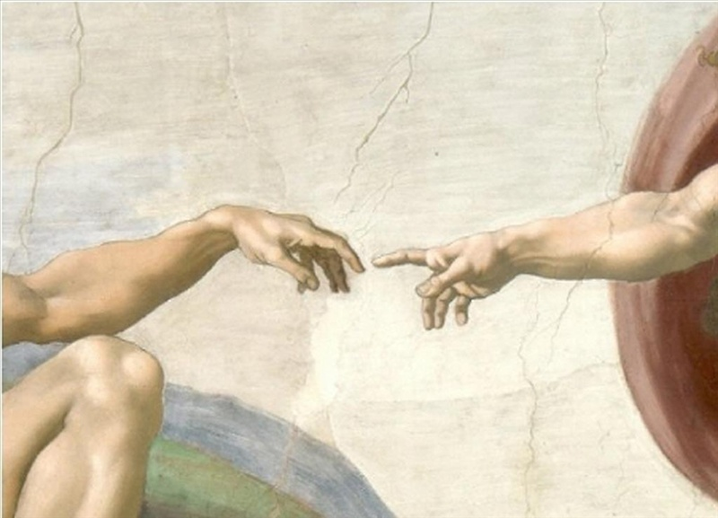
Do Now for Thursday, October 27
You don’t have to write the questions.
Do you recognize this? What is the name of artist?
This is by a very famous artist. Who is it?
It is a small part of a large work of art, do you know the name of the art?

Slide 5
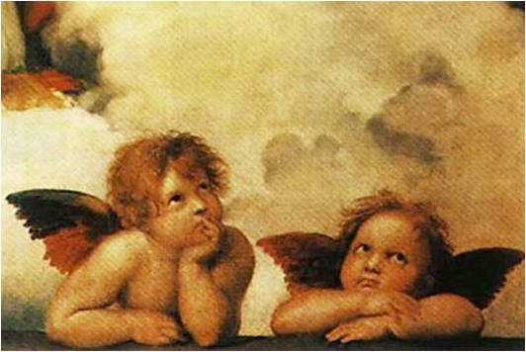
Do Now for TGIFday, October 28
You don’t have to write the questions.
Do you recognize this? What is the name of artist?
This is by a very famous artist. Who is it?
What’s different about this original work of art that you may see today?

