Slide 1
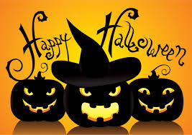
Do Now for MOnday, October 29
You have a quiz tomorrow! Use this questions to study – sorry – you have to write the question and the answer.
The Medici’s gained their power and influence in Florence through
Banking
Being Merchants
Political office
Medicine

Slide 2
Do Now for Tuesday, October 29
You have a quiz tomorrow! Use this questions to study – sorry – you have to write the question and the answer.
All of the following contributed to the birth of the Renaissance in Italy EXCEPT
A. It had thriving cities
B. It had a wealthy merchant class
C. Italy had access to Roman ruins and ancient manuscripts
from Greece
D. The bubonic plague had not reached the southern top of
Europe.

