Slide 1
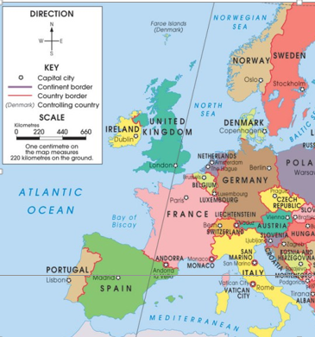
Do Now for Monday, October 10
This is a political map of Europe.
Write the country name, then list the capitals for: United Kingdom, France, Germany, Italy, Belgium, Spain, Portugal, Ireland, Norway, Sweden Denmark and Ireland.

Slide 2
Do Now for Tuesday, October 11
Explain how you know this is a political map.

Slide 3
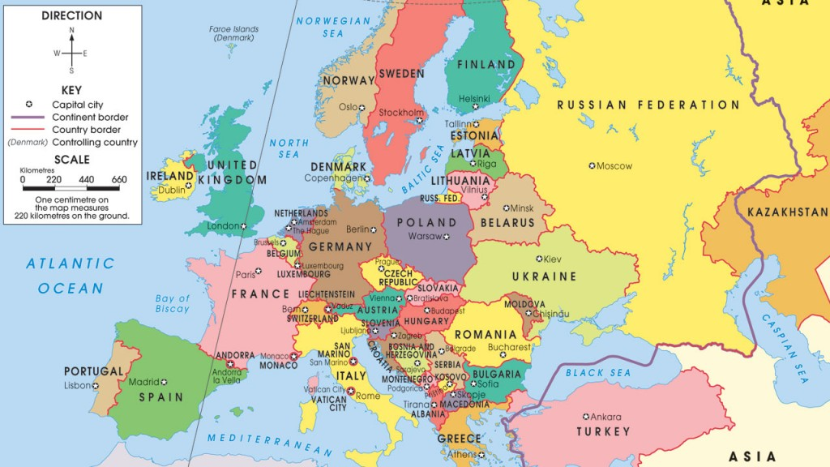
Do Now for TGIF October 14
This map is a bigger version then the one you saw the other day.
What does that dark line on the left of the map mean?
Find Turkey, what is unique about it?

