Slide 1
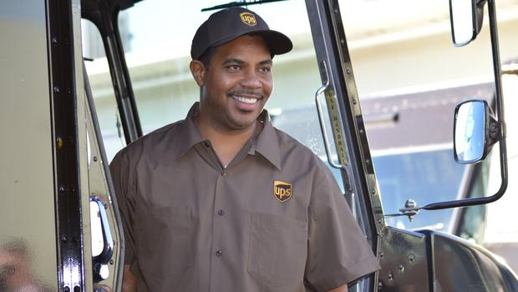
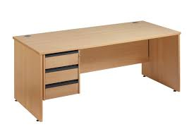
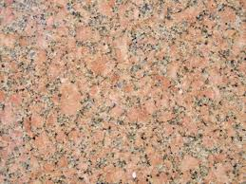
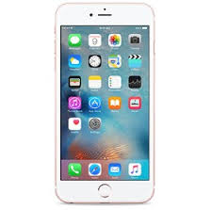
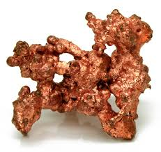
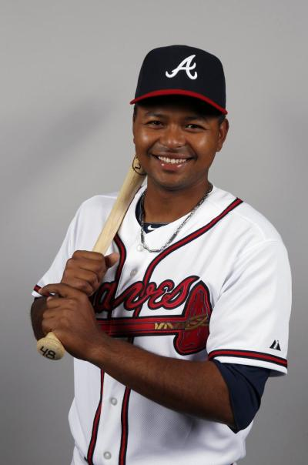
Do Now for Monday, August 22
Match the item to the correct factor
CAPITAL
LABOR
LAND

Slide 2
Do Now for Tuesday, August 23
List the two different types of capital.

Slide 3
Do Now for HUMPday, August 24
Make a list of 4 things that are factors of production. Put them in the right place!

Slide 4
Do Now for Thursday, August 25
What does it mean to ALLOCATE something?

Slide 5
Do Now for TGIFday, August 26
List three different ways (forms) of allocation.

