Slide 1
Do Now for Monday, August 29
AGAIN! ---- What does it mean to ALLOCATE something?

Slide 2
Do Now for Tuesday, August 30
AGAIN! ---- List at least three different forms of allocation

Slide 3
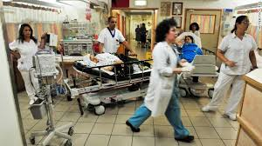
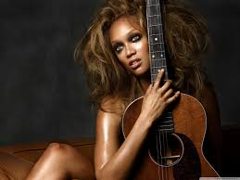
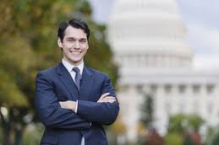
Do Now for HUMPday, September 1
Match the image with the allocation method that he or she would most likely favor when competing for a product that he or she wants.
Appearance and Personality
Force
Government
First Come-First Serve
Market

Slide 4
Do Now for Thursday, September 2
Define the following word for review purposes:
Scarcity
Opportunity Cost
Allocation

