Slide 1
Do Now for Tuesday, August 9
*Pass up parent signatures
*Get out your phone and sign up for REMIND
Take out your phone
Look at the board on the RIGHT SIDE—find your class.
Text to: 81010
Make sure you put in the @ sign, then the code for your class.
The computer will ask you for your name – please give your first and last name.
That’s it!
**If you’re a senior go ahead and do the “khsseniors” as well.

Slide 2
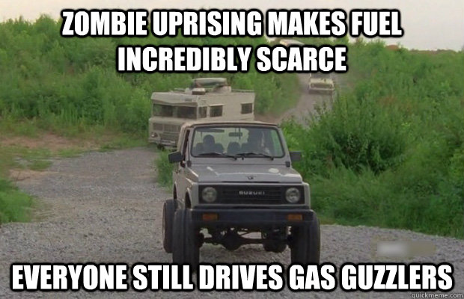
Do Now for HUMPday, August 10
What do you think the word SCARCE means??

Slide 3
Do Now for HUMPday, August 10
Answer: .
(especially of food, money, or some other resource) insufficient for the demand.

Slide 4
Do Now for Thursday, August 11
Define:
Scarcity
Factors of Production

Slide 5
Do Now for Thursday, August 11
Answer:
Scarcity -is the fundamental economic problem of having seemingly unlimited human wants in a world of limited resources.
Factors of Production -inputs that are used in the productionof goods or services in order to make an economic profit. The factors of production include land, labor, capital and entrepreneurship.

Slide 6
Do Now for TGIFday, August 14
Answer these questions:
What is the difference between human capital and financial capital?
2) What does GDP stand for
3) What is an entrepreneur?

Slide 7
Do Now for Monday, August 15
So you’re on an island in a group.
List:
One thing you would’ve picked that the others didn’t want too.
One thing you wish you could have an option to have that was NOT on the list.

Slide 8
Do Now for Tuesday, August 16
List the 4 items needs for FACTORS OF PRODUCTION!

Slide 9
Do Now for HUMPday, August 17
Are you ready for your quiz?
STUDY NOW!!!

Slide 10
Do Now for Thursday, August 18
Are you ready for your quiz?
STUDY NOW!!!

Slide 11
Do Now for TGIFday, August 19
Explain OPPORTUNITY COST!

