Slide 1
Do Now for Monday, October 3
Write the question and the correct answer.

Slide 2
ANSWER for Monday, October 3
Write the question and the correct answer.

Slide 3
Do Now for Tuesday, October 4
Write the question and the correct answer.
Which of the following is human capital that an art gallery owner could use for her art gallery
Light fixtures to help display the artwork
A security guard to protect the artwork
Knowledge of trend in modern art
A series of paintings by a prominent local artist

Slide 4
ANSWER for Tuesday, October 4
Write the question and the correct answer.
Which of the following is human capital that an art gallery owner could use for her art gallery
Light fixtures to help display the artwork
A security guard to protect the artwork
Knowledge of trend in modern art
A series of paintings by a prominent local artist

Slide 5
Do Now for Humpday, October 5
Write the question and the correct answer.
Which should ALWAYS be considered when making rational decisions?
marginal benefits and marginal costs
the real dollar amounts of the items
whether to use fiscal or monetary policy
how many opportunity costs there are

Slide 6
ANSWER for Humpday, October 5
Write the question and the correct answer.
Which should ALWAYS be considered when making rational decisions?
marginal benefits and marginal costs
the real dollar amounts of the items
whether to use fiscal or monetary policy
how many opportunity costs there are

Slide 7
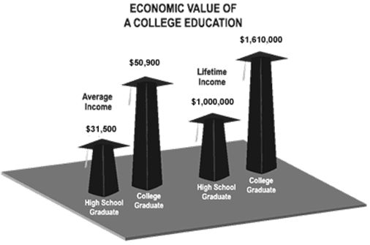
Do Now for Thursday, October 6
Write the question and the correct answer.
Which conclusion can be drawn from the graphic?
There is little difference in the lifetime incomes of college graduates and high school graduates.
College graduates will likely have a higher standard of living compared to high school graduates.
It is undesirable to graduate from college because you will be put in a higher tax bracket.
There is no economic value in graduating from High School.

Slide 8
ANSWER for Thursday, October 6
Write the question and the correct answer.
Which conclusion can be drawn from the graphic?
There is little difference in the lifetime incomes of college graduates and high school graduates.
College graduates will likely have a higher standard of living compared to high school graduates.
It is undesirable to graduate from college because you will be put in a higher tax bracket.
There is no economic value in graduating from High School.

Slide 9
Do Now for TGIFday, October 7
Write the question and the correct answer.
Which BEST describes productivity?
the interaction of buyers and sellers
the relationship of inputs to outputs
producing at high opportunity costs
trading based on absolute advantage

Slide 10
ANSWER for TGIFday, October 7
Write the question and the correct answer.
Which BEST describes productivity?
the interaction of buyers and sellers
the relationship of inputs to outputs
producing at high opportunity costs
trading based on absolute advantage

