Slide 1
Do Now for Monday, September 26
Remember: we’re doing sample test questions to increase your test taking skills – and by seeing your last test score you need more practice. WRITE THE QUESTION AND THE ANSWER.
Which basic economic problem does the U.S. share with all other nations?
Scarcity of resources
Lack of technology
Lack of public services
Too much government control

Slide 2
Do Now for Monday, September 26
Remember: we’re doing sample test questions to increase your test taking skills – and by seeing your last test score you need more practice. WRITE THE QUESTION AND THE ANSWER.
Which basic economic problem does the U.S. share with all other nations?
Scarcity of resources
Lack of technology
Lack of public services
Too much government control

Slide 3
Do Now for Tuesday, September 27
Remember: we’re doing sample test questions to increase your test taking skills – and by seeing your last test score you need more practice. WRITE THE QUESTION AND THE ANSWER.
A popular model used to illustrate the concept of opportunity cost is
Entrepreneurship
Paradox of value
Factors of production
Production possibilities curve

Slide 4
Do Now for Tuesday, September 27
Remember: we’re doing sample test questions to increase your test taking skills – and by seeing your last test score you need more practice. WRITE THE QUESTION AND THE ANSWER.
A popular model used to illustrate the concept of opportunity cost is
Entrepreneurship
Paradox of value
Factors of production
Production possibilities curve
IDEA

Slide 5
Do Now for HUMPday, September 28
Remember: we’re doing sample test questions to increase your test taking skills – and by seeing your last test score you need more practice. WRITE THE QUESTION AND THE ANSWER.
When you make a buying decision, your opportunity cost is the value of
The trade-off
Your next best alternative
Your satisfaction with your purchase
The interest the money would have earned had you saved it

Slide 6
Do Now for HUMPday, September 28
Remember: we’re doing sample test questions to increase your test taking skills – and by seeing your last test score you need more practice. WRITE THE QUESTION AND THE ANSWER.
When you make a buying decision, your opportunity cost is the value of
The trade-off
Your next best alternative
Your satisfaction with your purchase
The interest the money would have earned had you saved it

Slide 7
Do Now for Thursday, September 29
Remember: we’re doing sample test questions to increase your test taking skills – and by seeing your last test score you need more practice. WRITE THE QUESTION AND THE ANSWER.
Which of the following is not an example of economic decision making?
Using cost-benefit analysis
Building simple models
Writing a thesis statement
Taking small, incremental steps

Slide 8
Do Now for Thursday, September 29
Remember: we’re doing sample test questions to increase your test taking skills – and by seeing your last test score you need more practice. WRITE THE QUESTION AND THE ANSWER.
Which of the following is not an example of economic decision making?
Using cost-benefit analysis
Building simple models
Writing a thesis statement
Taking small, incremental steps

Slide 9
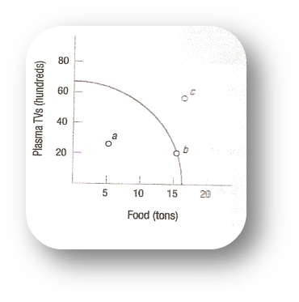
Do Now for TGIFday, September 30
Remember: we’re doing sample test questions to increase your test taking skills – and by seeing your last test score you need more practice. WRITE THE QUESTION AND THE ANSWER.
In the Production Possibilities Frontier, which points are attainable?
A and B
B and C
C
B only

Slide 10
Do Now for TGIFday, September 30
Remember: we’re doing sample test questions to increase your test taking skills – and by seeing your last test score you need more practice. WRITE THE QUESTION AND THE ANSWER.
In the Production Possibilities Frontier, which points are attainable?
A and B
B and C
C
B only

