Slide 1
Do Now: 8/17/16
Picture the coolest pair of sneakers you’ve ever seen. How do you think they were created?
Or
Design your own custom-made sneakers and describe your design in words.

Slide 2
SSEF 1 Explain why limited productive resources and unlimited wants result in scarcity, opportunity costs, and tradeoffs for individuals, businesses, and government. B. Define and give examples of productive resources (e.g., land (natural), labor (human), capital (capital goods), entrepreneurship.
Guiding Question: what does it take to create the things we want?
Objective: Define and differentiate between the four types of resources using real world texts

Slide 3
Factors of Production
The goods and services we want cannot be made without resources (factors of production.)
A bucket is strapped to this rubber tree to collect the latex

Slide 4
LAND
LABOR
FACTORS OF PRODUCTION
We will define all four…
Think of examples as you write!
CAPITAL
ENTREPRENEURSHIP

Slide 5
Land Resources
Resources found in nature
Examples: water, minerals, animals, and the forest
Challenge: Come up with your own example and add it!

Slide 6
Labor Resources
Any physical or mental work
Examples: a news reporter, cashier, or college professor

Slide 7
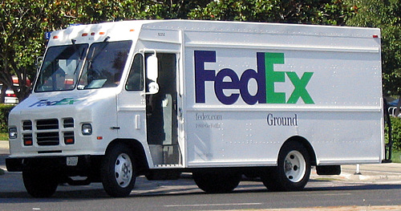
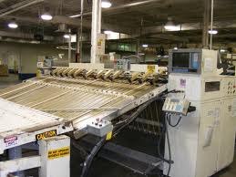
Capital Resources
Finished tools used to make or deliver other products
Examples: machines, delivery trucks, buildings, or factories

Slide 8
Entrepreneurship
New ideas, risk taking, or starting a business
Examples: inventions and founders of companies

Slide 9
Directions: When a new resource is announced, call out its factor of production.
FOR EXAMPLE:
LABOR
Doctor

Slide 10
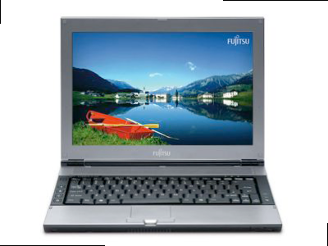
CAPITAL
Laptop

Slide 11
ENTREPRENEURSHIP
Founder of a Paper Company

Slide 12
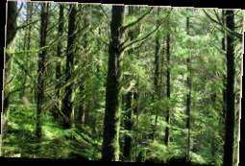
LAND
Trees

Slide 13
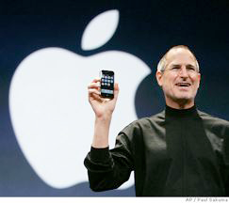
ENTREPRENEURSHIP
Steve Jobs, creator of the iPod

Slide 14
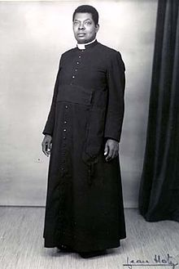
Priest
LABOR

Slide 15
60-Second Challenge
Cotton | Gold | Hammer
Truck Driver | Oak Trees | Telephone
Accountant | Corn | Henry Ford
Lawyer | Cash Register | Receptionist
LAND
CAPITAL
LAND
LAND
CAPITAL
LABOR
LABOR
LAND
ENTREPRENEUR
LABOR
CAPITAL
LABOR

Slide 16
Product Analysis Sample
Product: Desk
Land: Tree, Metal
Labor: Lumberjack, Truck Driver, Cashier
Capital: Saw, Truck, Welding Machine
Entrepreneurship: Company Owner, Inventor

Slide 17
Product Analysis Sample
Pick 3 Products from this list:
Textbook, t-shirt, blue jeans, cell phone, potato chips, pencil
A. Land:
B. Labor:
C. Capital:
D. Entrepreneurship:

