Slide 1
Three Major World Religions
SSWH1- Analyze the origins, structures, and interactions of complex societies in the ancient Eastern Mediterranean from 3500 BCE to 500 BCE. C. Explain the development of monotheism; include the concepts developed by the ancient Hebrews, and Zoroastrianism. SSWH3-examine the political, philosophical, and cultural interaction of Classical Mediterranean societies from 700 BCE to 400 CE. d. Describe polytheism in the Greek and Roman world and the origins and diffusion of Christianity in the Roman world. SSWH5-trace the origins and expansion of the Islamic World between 600CE and 1300 CE. a. Explain the origins of Islam and the growth of the Islamic Empire. f. Analyze the relationship between Judaism, Christianity, and Islam.

Slide 2
You need to know some basic terminology first - - - -

Slide 3
You need to know some basic terminology first - - - -

Slide 4
You need to know some basic terminology first - - - -

Slide 5
You need to know some basic terminology first - - - -

Slide 6
You need to know some basic terminology first - - - -

Slide 7
You need to know some basic terminology first - - - -

Slide 8
You need to know some basic terminology first - - - -

Slide 9
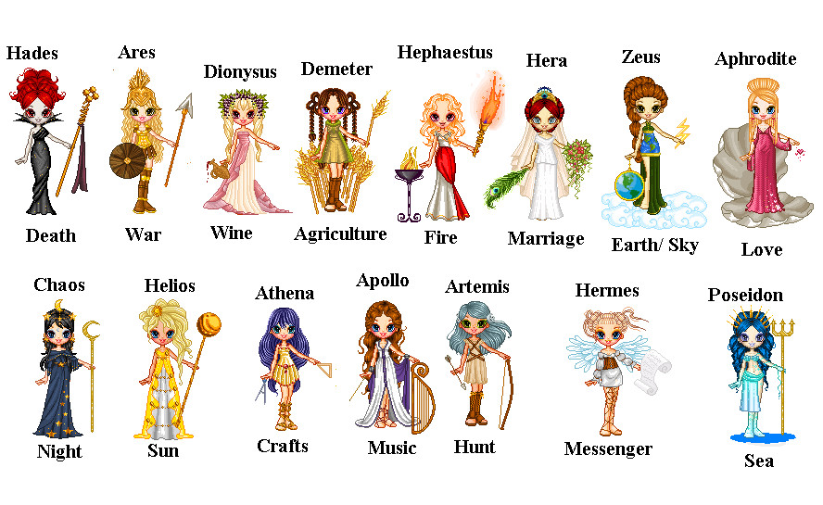
Polytheism:

Slide 10
3 major religions you’re learning about today:
In order of origination:
Judaism
Christianity
Islam

Slide 11
Judaism [C3 S4] {more than 5000 years ago}
The Hebrews, who would come to be called Jews, originated in Mesopotamia. The Jews were the first group of people who were Monotheistic. Their history comes from the first five books of the Hebrew Bible called the Torah. Christians call these books the Old Testament. According to the Torah, God, who they also called Yahweh, chose Abraham to be the “father” of the Hebrew People. He would lead them to the promised land – out of Ur in Mesopotamia to Canaan, the promised land. Because of a terrible drought, his people went to Egypt. It was there that they would become slaves. To the Hebrews, God was not physical and images should not be made of him. Much later, Moses would lead the Jews out of Egypt back to their homeland. It was on this journey that Moses was given the Ten Commandments which would become the covenant between God and the Hebrew people.

Slide 12
Christianity [C6 S3] {more than 2000 years ago}
Came about during the time of the Roman Empire. The Romans were polytheistic and required all Romans to worship their gods. The Jewish Kingdom was controlled by the Romans. Sometime around 6-4BCE, a Jew named Jesus was born in and grew up in Palestine (carpenter). When he was @30 he started preaching publically about his beliefs which included monotheism and the principles of the 10 commandments. But mostly, he emphasized God’s personal relationship to each human being. He stressed the importance of people’s love for God, their neighbors, their enemies and themselves. He taught that God would end wickedness and establish an eternal kingdom for those who repented their sins. He gained many followers and the Romans became threatened by his popularity. After Jewish leaders denied he was the messiah, he was arrested for defying the authority of Rome and crucified. Christianity spreads through the work of his apostles.

Slide 13
Islam [C10 S1] {@610AD}
Came about in the Middle East–what is modern day Saudi Arabia in Mecca, a big trade city on the coast of the Red Sea. It was also a holy city where pilgrims would come to worship at an ancient shrine called the Ka’aba that was associated to Abraham. Many religions existed in the area including many Christians and Jews. It was here that Muhammad was born. He was a trader and business manager for a wealthy business woman named Khadijah who he would later marry. Once when he was meditating he heard the voice of the angel Gabriel who told Muhammad he would be the messenger of Allah. He began to teach that Allah was the only God and all other gods should be abandoned. He gained followers, but many feared Mecca would lose prestige if they followed Muhammad so he left but would return stronger. There are 5 beliefs or pillars of Islam: Faith, Prayer, Alms, Fasting and Pilgrimage (page 267)

