Slide 1
SSWH8 The student will demonstrate an understanding of the development of societies in Central and South America

Slide 2
a. Explain the rise and fall of the Olmec, Mayan, Aztec, and Inca empires.

Slide 3
Olmec Empire (1200-400 B.C.)

Slide 4
Olmec Empire (1200-400 B.C.)
One of the earliest known civilizations in the Americas
Olmec's settled by the rivers for good soil
Farming led to the growth and development of towns
The Empire ended due to the changes of soil making the production of crops decrease

Slide 5
Olmec Empire (1200-400 B.C.)
Known for their creation of colossal stone heads of their rulers
Historians do not know what the Olmec’s called themselves. Olmec is Aztec for ‘rubber people’.

Slide 6
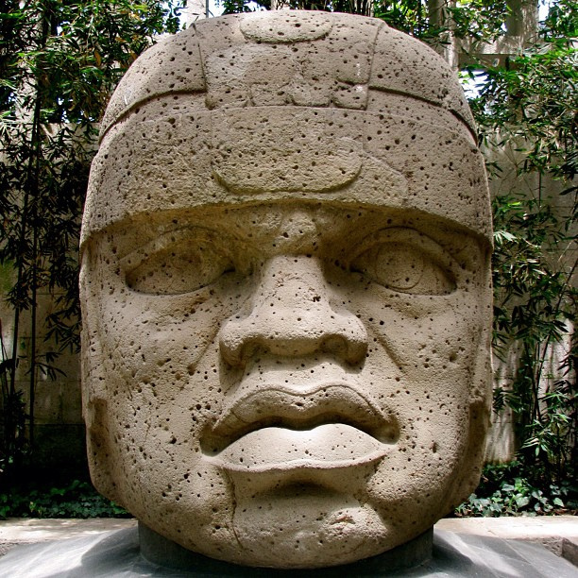
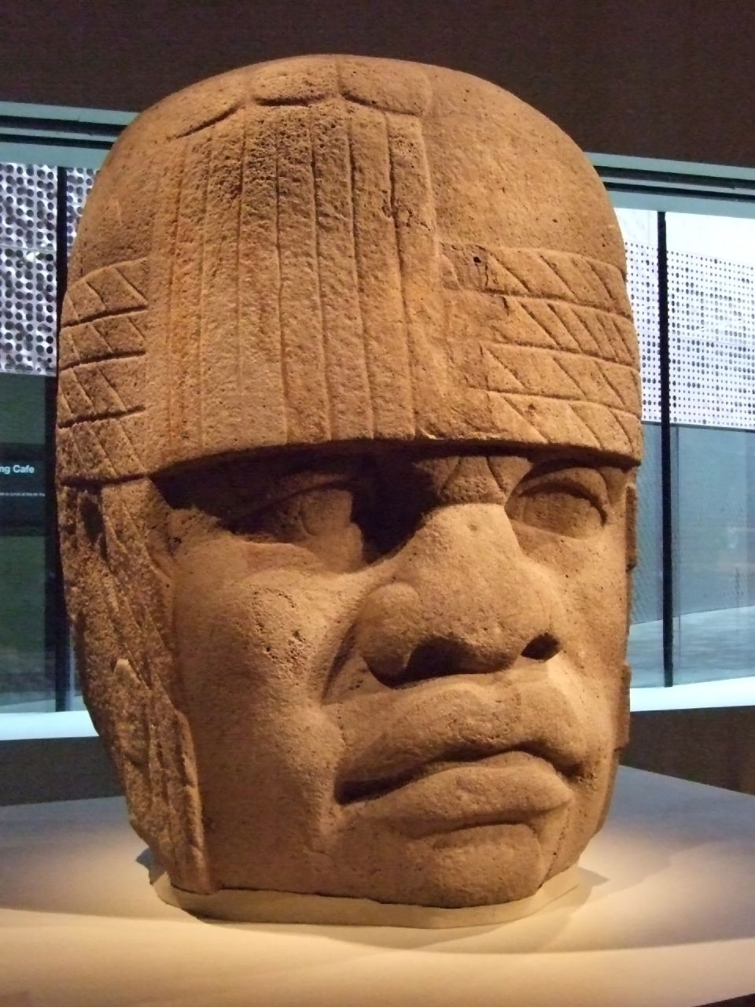
The Olmec Empire (1200-400 B.C.)

Slide 7
Mayan Empire (200 B.C.-900 A.D.)

Slide 8
Mayan Empire (200 B.C.-900 A.D.)
The Mayan’s were heavily influenced by the Olmecs
They built independent city states linked through trade and alliances
It is unknown how the empire came to an end. Theories how the empire fell are from the wars declared between the city states, disruption of trade, and the depletion of natural resources

Slide 9
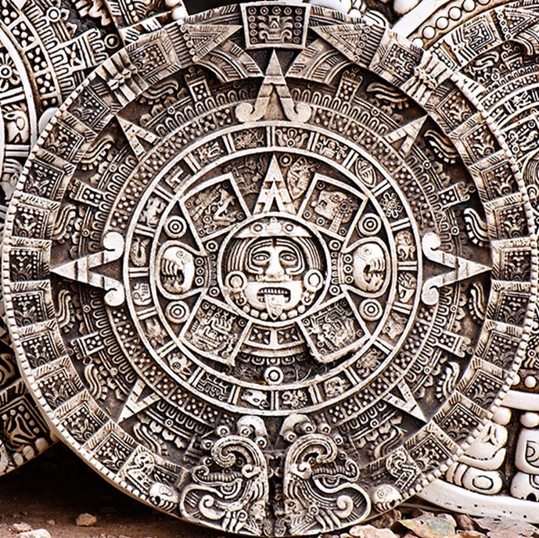
Mayan Empire (200 B.C.- 900 A.D.)
Famous for the Mayan calendar
The Mayans invented the “0” and the ball game

Slide 10
Aztec Empire (1400-1521 A.D.)

Slide 11
Aztec Empire (1400-1521 A.D.)
The Empire formed through the alliance of three city states: Tenochtitlan, Texcoco, and Tlacopan
The capital, Tenochtitlan, had a population of 200-400,000 people
The arrival of Hernan Cortes and his Spanish forces brought an end to the Aztec Empire

Slide 12
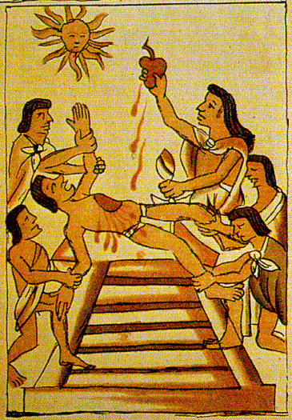
Aztec Empire (1400-1521 A.D.)
Famous for their human sacrifices to the gods

Slide 13
Inca Empire (1460-1532 A.D.)

Slide 14
Inca Empire (1460-1532 A.D.)
Settled in a fertile valley, and went on to conquer the western coast of South America
Established their empire through means of diplomacy and military strength
Was the largest empire in pre-Columbian America
During an Incan Civil War, Spanish conquistador Francisco Pizarro was able to bring an end to the already weakened Inca Empire

Slide 15
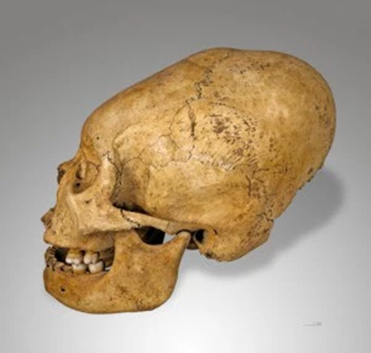
Inca Empire (1460-1532 A.D.)
The Incas found deformed skulls beautiful. Parents would purposely wrap bandages tightly around the heads of their children to cause this deformation.

Slide 16
b. Compare the culture of the Americas; include government, economy, religion, and the arts of the Mayans, Aztecs, and Incas.

Slide 17
Government
Mayans
Aztecs
Incas
Independent city-states were ruled by kings/priests. Power gained through the means of hereditary.
A single emperor with reginal rulers who paid tributes to the emperor.
Led by a king with the empire divided into smaller units. The capital was connected to all towns through roads.

Slide 18
Religion
Mayans
Aztecs
Incas
Main importance to the Mayan life. Worshiped multiple gods. Some human sacrifices. Mainly worshiped gods through offerings and prayer.
Main importance to Aztec life. Worshiped multiple gods. Used large scale human sacrifices in order to praise the Sun God.
Ancestor worship with human sacrifices on certain occasions.

Slide 19
Economy
Mayans
Aztecs
Incas
Based on trade and agriculture.
Based on agriculture and trade. Goods were used as payment from the conquered populations.
Through trading and farming.

Slide 20
Arts
Mayans
Aztecs
Incas
Built pyramids. Developed the famous Mayan calendar that was based on astronomy and an advanced writing system.
Developed a calendar similar to the Mayan’s calendar. Built pyramids. Created paintings and pottery with war based themes.
Worked on metal, cloth, and pottery.

