Slide 1
We’ve got about 2 ½ weeks to learn the three GPS’s above. Are you ready??

Slide 2
SSEF6 Explain how productivity, economic growth, and future standards of living are influenced by investment in factories, machinery, new technology, and the health, education, and training of people. a. Define productivity as the relationship of inputs to outputs.
Productivity is the amount of output (goods and services) produced while using a certain amount of input (labor, time, technology, capital goods etc.) Labor productivity is the amount of goods and services a worker can produce in a given period of time.
**If you find a way to increase output without increasing input, productivity increases.**

Slide 3
b. Explain how investment in equipment and technology can lead to economic growth.
Equipment = necessary items for a particular purpose
Technology = the application of scientific knowledge for practical purposes, especially in industry.
ECONOMIC GROWTH = IS AN INCREASE IN THE AMOUNT OF GOODS AND SERVICES PRODUCED PER HEAD OF POPULATION OVER A PERIOD OF TIME
Investing heavily in new capital and technology is related to economic growth

Slide 4
c. Explain how investments in human capital (e.g., education) can lead to a higher standard of living.
Investment = to invest is to allocate money (or sometimes another resource, such as time) in the expectation of some benefit in the future.
Education = When a person invests in themselves to become an expert in a particular field

Slide 5
Human capital: education
Human capital is also known as labor
Your education and skill level allow you to sell your labor
Productivity rises when workers become more productive due to higher education and skill level
Generally – higher education and greater skills mean higher earnings
High school degree = @20,000/year
Bachelor’s degree = @40,000/year
Master’s degree = @50,000/year
Doctorate Degree = @70,000/year

Slide 6
SSEPF1 The student will apply rational decision making to personal spending and saving choices
Explain that people respond to positive and negative incentives in predictable ways
Use a rational decision making model to select one option over another
Create a saving or financial investment plan for a future goal

Slide 7
A. Explain that people respond to positive and negative incentives in predictable ways
Incentive: reward that a person is likely to receive if he or she behaves in a certain manner.
A. Positive incentive: positive reward
B. Negative incentive: negative reward

Slide 8
B. Use a rational decision making model to select one option over another
NAME | BUILD FRAME | INSERT GEARS | PUT ON FACE | TOTAL TIME
T-PAYNE | 4 MINUTES | 7 MINUTES | 9 MINUTES
LUKE BRYAN | 7 MINUTES | 9 MINUTES | 4 MINUTES
BILLY IDOL | 9 MINUTES | 4 MINUTES | 7 MINUTES
There are three steps to building a clock. They are to build the frame, insert the gears, and attach the face plate. The time it takes each person to do each task is located in the table above.
Method 1- Find the total amount of time it would take each person to make a clock from start to finish and list it in the table under total time in the table above.
Method 2- If you used specialization, what task would each person do?
T-PAYNE
LUKE BRYAN
BILLY IDOL
How long would it take using specialization to build 1 clock? _________

Slide 9
c. Create a saving or financial investment plan for a future goal
Know what you want – you need to understand what you’re truly saving for…a new car, senior dues, college?
Get in the right mindset - if setting aside money to save makes you feel deprived – change your attitude. By saying “no” right now – you saying a big “yes” to something bigger and better in the future.

Slide 10
SSEPF6 The student will describe how the earnings of workers are determined in the marketplace
Identify skills that are required to be successful in the workplace
Explain the significance of investment in education, training and skill development

Slide 11
A. Identify skills that are required to be successful in the workplace
Ability and willingness to learn new skills
Critical thinking and problem solving
Collaboration and team work
Positive attitudes and behaviors
Being responsible
Being adaptable
Working safely
Working with others
Communication
Using numbers

Slide 12
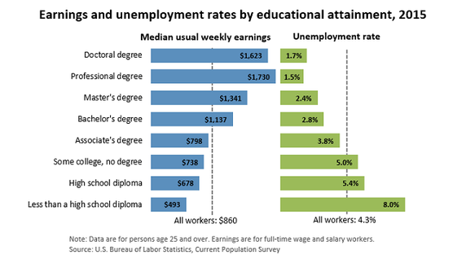
B. Explain the significance of investment in education, training and skill development

Slide 13
job training and SKILL Development
Increases productivity
Higher pay
Job security
Types of training: working alongside a skilled worker, rotating workers between jobs so they are multi-skilled and Informal seminars

