Slide 1
To review
I just want to make sure (for sure) you know a couple of things before we move forward.

Slide 2
Marginal Costs
Think of the word “margin” – look at your paper. Now – What do you think it means?
If you have change that is “marginal” that means in small amounts.
What does the word “incremental” mean – think increments. What does that mean?

Slide 3
What does CONCAVE mean in ECONOMICS
Concave – CURVES OUTWARD
For production possibilities – that means that line BOWS outward.

Slide 4
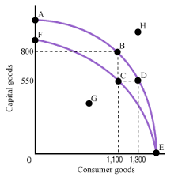
If you see something like this-what does it probably mean...

Slide 5
We haven’t talked about the stock market – because I was told that comes later – hmph. But its on the test. Another HMPH.
SO……. The stock market. Allocation. Think about it.

Slide 6
Rational Economic Decision?
Think about the words:
Rational
Economic
Decision
Now, think about marginal costs (remember marginal) and benefits. You have to WEIGH each and make a RATIONAL DECISION!

