Slide 1
How did Michelangelo Carve David?
Hands-On Learning

Slide 2
First, watch this….Art History in a Hurry!

Slide 3
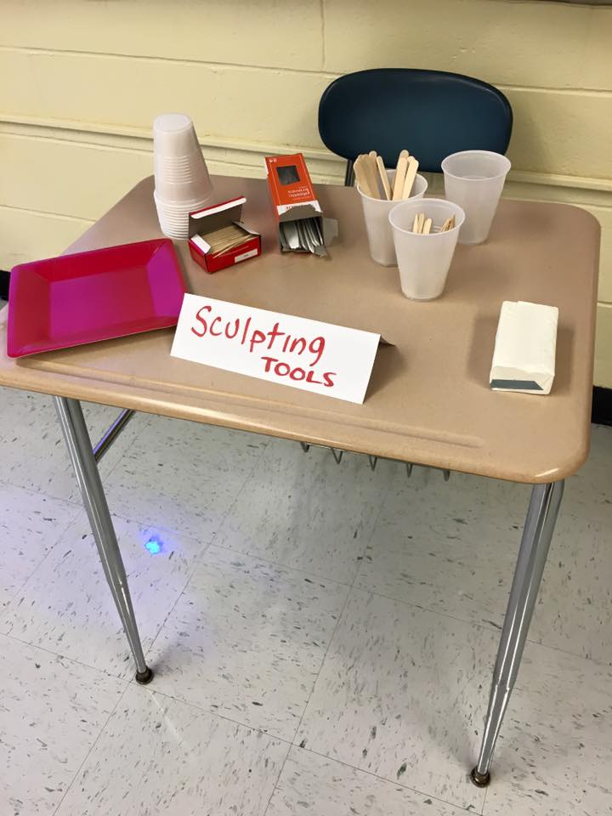
How hard is it to carve a design from one solid piece of “marble?”
Prep your area with newspaper & a paper towel
2. Get your tools – knife, toothpick, fork
3. In your mind’s eye, determine a design you’d like
to try.
4. Begin carving.
5. At the end, put your soap, tools and paper towel in
the plastic bag.
6. Put your name on the bag.
7. Put your “art” bag on the work table.

Slide 4
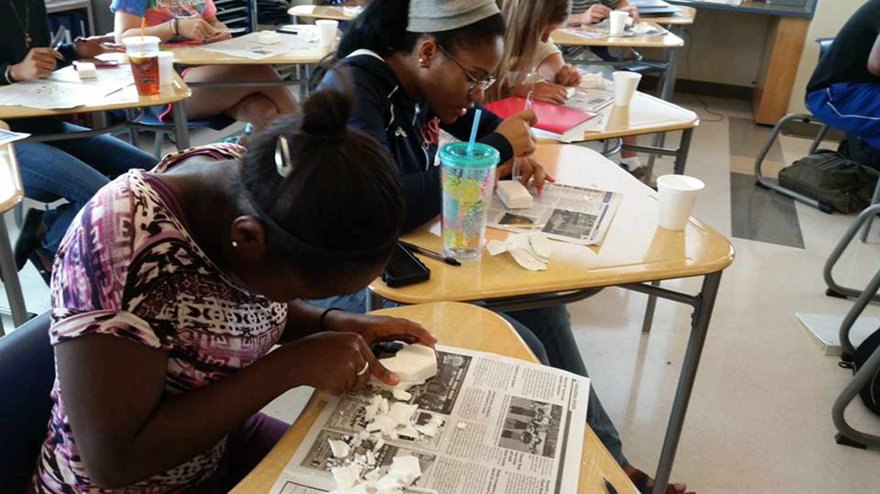
This is how yall should look….

Slide 5
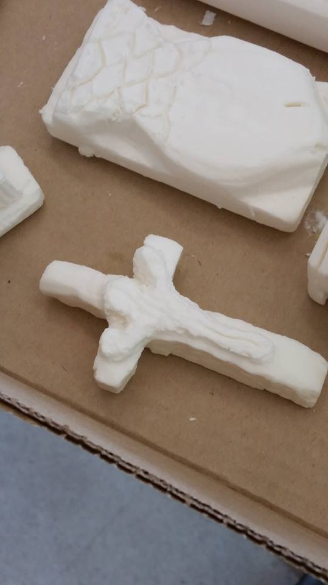
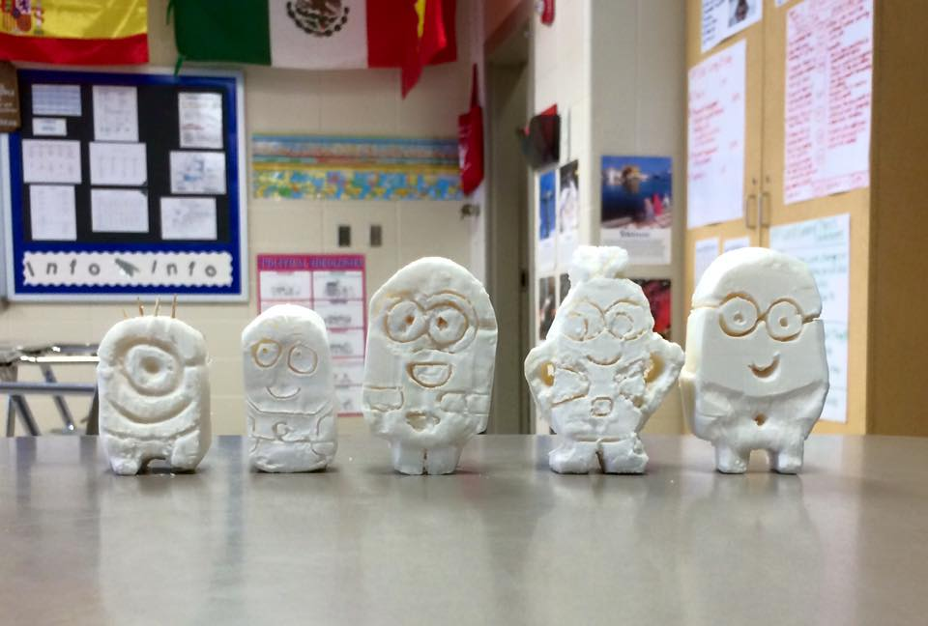
Some ideas for you…

Slide 6
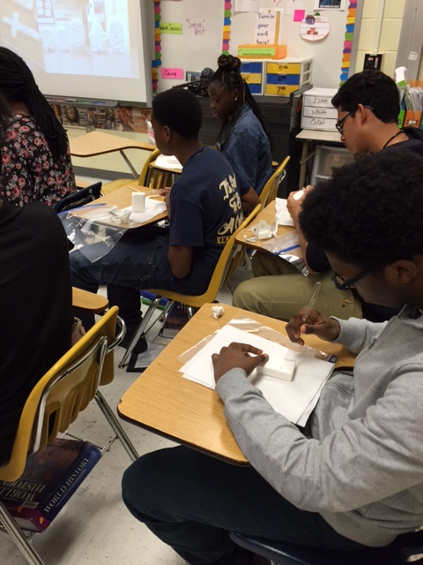
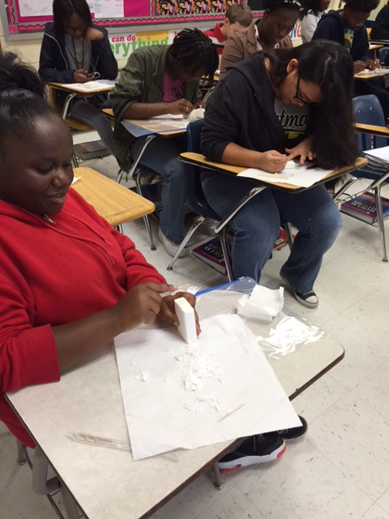
How did we do?

