Slide 1
Specialization Graphing Production Rational Decisions
GPS: SSEF2 The student will give examples of how rational decision making entails comparing the marginal benefits and the marginal costs of an action.
a. Illustrate by means of a production possibilities curve the trade offs between two options.
b. Explain that rational decisions occur when the marginal benefits of an action equal or exceed the marginal costs.

Slide 2
SPECIALIZATION
1ST

Slide 3
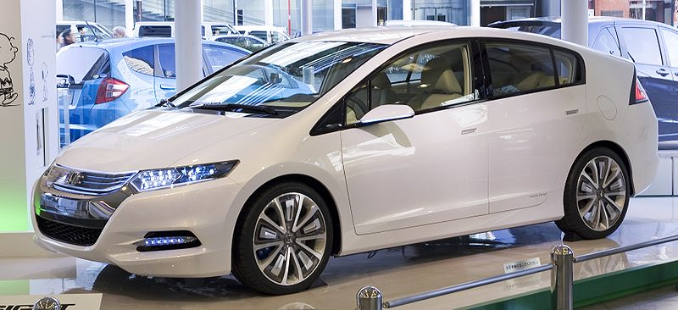
Efficiency: Definition
Using the smallest amount of resources to get the greatest amount of output
This hybrid car is very efficient because it can drive farther using less gas.
What other examples can you think of?

Slide 4
Specialization: Definition
The focus of a worker on a specific task or activity
A Doctor could specialize in children’s medicine

Slide 5
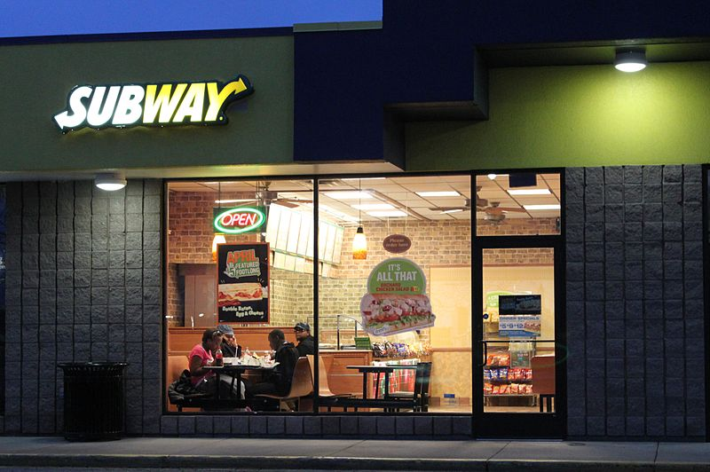
Division of Labor: Definition
Splitting up the work so that each person has one job and can specialize in what they do best.
At Subway they use a division of labor to assign different jobs to different employees: how do you think this works?

Slide 6
How Does D of L work in…
A Walmart?
In a Walmart, employees would specialize in one task within the store. For example, one employee’s job might be to check customers out and another’s might be to stock shelves depending on their strengths.
This might lead to faster completion of the task and thus more profit. It could also lead to the second employee feeling bored or lonely on a day-to-day basis.

Slide 7
Graphing Production
2ND

Slide 8
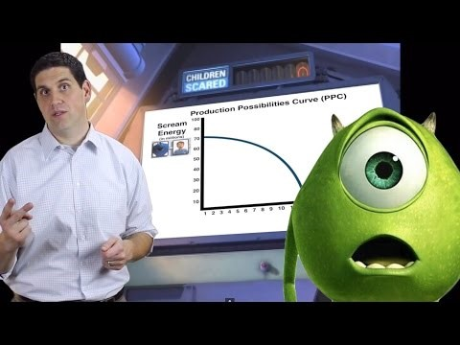
A little visual help….

Slide 9
Warm-up: Graphing
Copy the graph and plot the points listed.
Y
(X,Y)
Example: A (2,4)
B (5,2)
C (4,3)
D (7,1)
E (1,6)
A
1
X
1

Slide 10
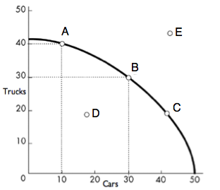
Production Possibilities Frontier (PPF)
A PPF graph shows how much of two goods we can make in a certain period of time.
This PPF shows how many cars and trucks Ford can make in a day

Slide 11
What the PPF tells us about our options…
Points on the line are possible and efficient.
Points inside the line are possible but inefficient.
Points outside the line are impossible given the current resources.
Possible and efficient!
Impossible right now
Possible but inefficient
Notes:
Refresh definition of efficient and inefficient and underline on notes
CFU past knowledge of what resources are, what resources would be needed to make cars/trucks, and what these points mean for those concrete examples
Model opportunity cost of A to B

Slide 12
PPF: Let’s Make One Together
Polo makes two products: shirts and pants.
In one hour, Polo can make seven pairs of pants or six shirts.
Or, Polo could make a combination of both and produce five pairs of pants and four shirts.
Notes:
Student graphs on board as class follows on their handout and directs student at board.
Common misunderstanding is plotting point (6,7) instead of (0,7) and (6,0). Ask: is that right? What does that mean? What information are we trying to show with this point? if the class does not correct this before moving on
Ask class opportunity cost of A to B

Slide 13
PPF: Let’s Read One Together
If Polo decides to use all its resources to make pants, what do they lose?
What’s the opportunity cost of producing at point C?
Should we produce at point E? Why or why not?
Should we produce at point D? Why or why not?
What choice would you make? Why?
E: (7,8)
A: (0,6)
Shirts
C: (5,4)
D: (2,2)
B: (7,0)
Pants

Slide 14
PPF: Creating Our Own
What are we making?
How much can we make?
What our options?
What is our decision? Why?
Notes:
Students have 60 seconds to make as many paper airplanes as possible; then track data.
Students have 60 seconds to draw as many cars as possible; track data.
Students have 60 seconds to make any combination of the two they want (>1/ea)
Then they turn data into a PPF and we discuss the options/decision/opportunity costs

Slide 15
Rational Decisions
3RD

Slide 16
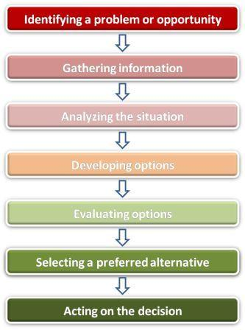
Rational Decisions
Every time a choice is made something is given up. Rational choice is taking the things with greater value and giving up those with lesser value.

