Slide 1
In order to make a rational economic decision, one must
(A) be an entrepreneur. (EF2b)
(B) understand capital investments.
(C) be aware of the difference in compound and simple interest
(D) be able to assess marginal costs and benefits.

Slide 2
Due to a scarcity of resources, (EF1a)
(A) every society must undertake central planning.
(B) the government must decide how to allocate available
resources.
(C) some members in each society must live in poverty.
(D) every society must choose among competing uses of
available resources.

Slide 3
In order for Jamie to paint one additional portrait, it will cost her $50.00. The good news is that, if she paints it, she can probably sell it for $250.00. Which of the following equals Jamie’s marginal cost? (EF2b)
(A) $50 (B) $200 (C) $250 (D) $300

Slide 4
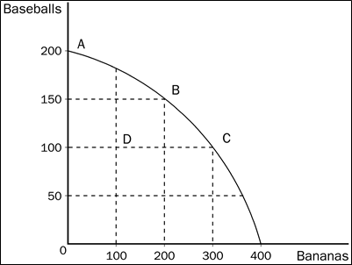
What is the opportunity cost of producing 200 bananas?
(EF2a)
(A) 50 baseballs (B) 100 baseballs
(C) 100 bananas (D) 300 bananas

Slide 5
the movement from point C to point D was most likely caused by
(A) unemployment.
(B) a decrease in society’s preference for bananas.
(C) fewer resources for production.
(D) All of the above are correct.

Slide 6
The costs of producing each additional unit (“just one more”) of a particular product is called what? (EF2b)
(A) fixed costs (B) marginal costs
(C) total costs (D) variable costs

Slide 7
It describes the different combinations of output of any two goods [x and y, for example] that can be produced given different combinations of the scarce inputs (EF2a)
(A) marginal analysis
(B) opportunity cost
(C) production inputs
(D) production possibilities model

Slide 8
Which of the following would most likely have caused the production possibilities frontier to shift outward from A to B in the graph shown above? (EF2a)
(A) an increase in resources necessary to produce capital goods
(B) an improvement in the technology of producing consumer
goods
(C) an increase in the overall level of technology in the economy
(D) an increase in unemployment
Possible Combinations
Cars Boats
125
60 120
120 105
170 80
200 60
225 30
250 0

Slide 9
Using the Possible Combinations schedule above, what is the marginal opportunity cost for increasing boat production from 80 to 105? (EF2a)
(A) 50 cars (B) 25 cars
(C) 50 boats (D) 25 boats

Slide 10
Which of the following is not an example of land? (EF1b)
(A) minerals (B) fish
(C) water (D) wood chair

