Slide 1
The RENAISSANCE/REFORMATION
GPS: SSWH9 The student will analyze change and continuity in the Renaissance and Reformation.
d. Analyze the impact of the Protestant Reformation; include the ideas of Martin Luther and John Calvin.
e. Describe the Counter Reformation at the Council of Trent and the role of the Jesuits.
f. Describe the English Reformation and the role of Henry VIII and Elizabeth I.
g. Explain the importance of Gutenberg and the invention of the printing press.

Slide 2
Causes of Protestant Reformation
HUMANISM has people questioning the church because of questionable activities
Popes who ruled during renaissance focused on personal pleasure and wars
Church members fathered children and some married
Many priests were poorly educated
Some drank to excess and gambled

Slide 3
Causes of Protestant Reformation cont.
2. PRINTING PRESS helps to spread critical ideas about the church
Chinese block printing arrives in Europe in 13th century
1440, Johann Gutenberg, German printer, creates from several technologies – the moveable type printing press
It CHANGES Europe by satisfying the Renaissance demand for knowledge and information through books.
first book printed is the bible.
Books are now cheap enough that many people could buy them
EFFECT – rise of literacy, increased desire for learning, creates discoveries, questioning of politics & religion

Slide 4
Causes of Protestant Reformation cont.
3. People didn’t like the sale of indulgences
An indulgence is a pardon of a sin in which the sinner must perform the penalty given by the priest as a way of forgiveness
priest named Tetzel was raising money to rebuild St. Peter’s Cathedral in Rome. Tetzel “sold” indulgences or let people “buy” their way into heaven.
A monk and a teacher thought this practice was wrong and tried to change it.

Slide 5
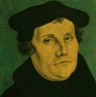
Martin Luther
monk and teacher who didn’t like Tetzel selling indulgences
protested by writing the “95 Theses;” statements about problems within the church & then nailed it to the doors of his church to invite scholars to debate him
Someone copied these statements and took them to a printer – he becomes known all over Germany

Slide 6
Martin Luther’s Ideas
1. people win salvation only by faith in God’s gift of forgiveness
2. All church teaching should be based on the words of Bible
3. All people of faith were equal – people do not need the priests to interpret the Bible for them

Slide 7
Martin Luther & Martin Luther King
They shared much more than a name. They both changed the worlds they lived in, many would argue for the better. They were reformers and leaders and they were men of faith.
In fact, Martin Luther King was a minister in the Baptist Church, one of the strands of Christianity derived from the Protestant faith, the very faith Martin Luther is credited with inspiring.
Indeed, Martin Luther King was born Michael King in 1929, it was as a teenager he chose to change his name to Martin Luther King Jr, after his father the preacher.
A single issue for each of them was to spark their lifelong battles for reform. For Martin Luther, the Catholic monk, it was his parishioners buying indulgences, purchasing their salvation to fill Rome's coffers.

Slide 8
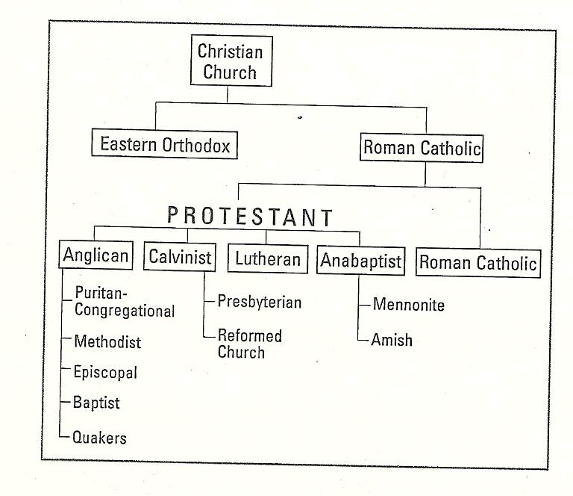
Reformation = RELIGIOUS CHANGE

Slide 9
John CALVIN
Continues the teachings of Martin Luther but with some differences:
Men and women are sinful by nature
God chooses the “elect” to save and God who will be saved--“predestination”

Slide 10
Counter Reformation = Catholic Reformation
Movement to help Catholics to remain loyal to the Catholic church
Council of Trent – church leaders met to create changes (p499)
New religious orders came about
Jesuits – founded by Ignatious of Loyola – they had 3 activities; founded schools, convert non-christians to Catholicism and stop the spread of Protestantism

Slide 11
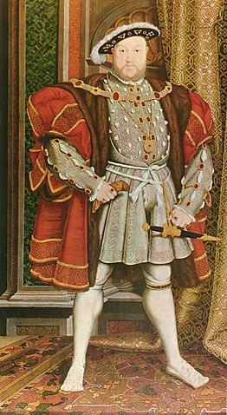
Henry VIII and the English Reformation,
Henry VIII, King of England from 1509-1547
Henry wants an heir; must be a SON
Henry is forced to marry his older brother’s girlfriend; they are both CATHOLIC – they only have 1 child – a daughter; MARY
Henry wants a DIVORCE; no divorce in Catholicism – calls Parliament into session asks them to pass a set of laws to end the Pope’s power in England. This is called the Reformation Parliament (Eng Ref)

Slide 12
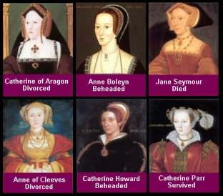
HENRY’S WIVES

Slide 13
Catherine – married 24yrs, births MARY I in 1516 (aka Bloody Mary)
Ann – births Elizabeth I, 1533 (aka Virgin Queen); executed in 1536
Jane – births Edward VI, 1537; dies in birth
Henry dies at the age of 55 from syphilis (venereal disease) and cirrhosis (liver disease)

Slide 14
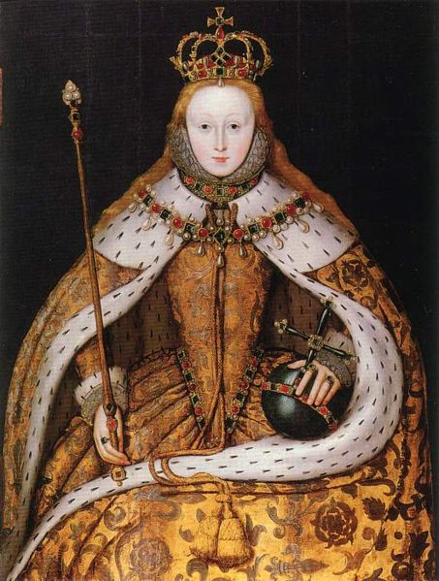
Elizabeth I (role in English Reformation)
Edward VI – becomes king at the age of 9; rules for 6 years (sickly) [protestant]
Mary I – comes to the throne in 1553 – restores Catholic Church – persecutes Protestants; marries Philip II of Spain
Elizabeth I – comes to the throne in 1558 – restores Protestant Church – halts all religious persecution; sets up the Church of England or the Anglican Church; Greatest Monarch in British history

Slide 15
“CARD ME” Quiz
The MAJOR impact of the PRINTING PRESS was the rise of ___________________.
Martin Luther started the Protestant Reformation by nailing his ___ ______ to the door of his church.
The ________ _________ is the Catholic Church’s response to the Protestant Reformation.
Henry VIII started the English Reformation because he wanted a _____________.
Elizabeth I sets up the Church of ___________.

