Slide 1
The RENAISSANCE

Slide 2
THIS is what you need to learn
GPS: SSWH9 The student will analyze change and continuity in the Renaissance and Reformation.
a. Explain the social, economic, and political changes that contributed to the rise of Florence and the ideas of Machiavelli.
b. Identify artistic and scientific achievements of Leonardo da Vinci, the “Renaissance man,” and Michelangelo.
c. Explain the main characteristics of humanism; include the ideas of Petrarch, Dante, and Erasmus.

Slide 3
social, economic, and political changes
After the middle ages – with the crusades, plague & hundred years war – people wanted to celebrate LIFE – they survived…
People began to question the CHURCH using art and literature – so new STYLES of expression evolved
This is what begins the change.

Slide 4
Social Changes
begins in NORTHERN ITALY
Why? Thriving cities, wealthy merchants & heritage of Greece & Rome
1) innovations in art & literature
2) new values – importance of the individual

Slide 5
Political & Economic Changes
RISE OF FLORENCE: small city-state in N. Italy
Wealthy merchants dominate politics
No social ranking – so had to be smart to make it
Power & wealth came from personal merit
Florence’s powerful family were the MEDICI’s who power came from BANKING; used this power to influence who else would hold power

Slide 6
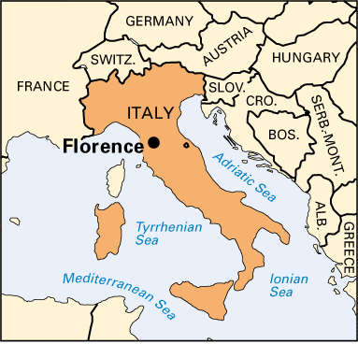

Slide 7
Political Changes
Machiavelli - diplomat, philosopher, musician, etc. Wrote The Prince - a guide for leadership.
His ideas: trick your enemies & own people for the good of the state; do not worry what is morally right; lie to your people if need be.
the modern political word Machiavellian—the use of cunning and deceitful tactics in politics.

Slide 8
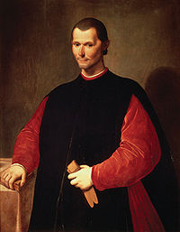
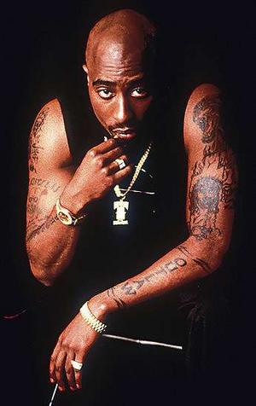
Machiavelli

Slide 9
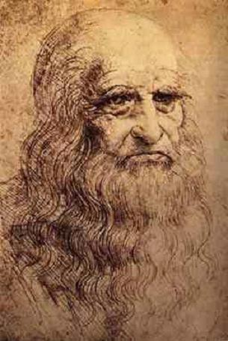
Artistic Achievements Leonardo da Vinci
greatest artists of all time
Genius, Architect, sculptor, painter, designer, inventor, wrote backwards, great interest in the human body, created military machines

Slide 10
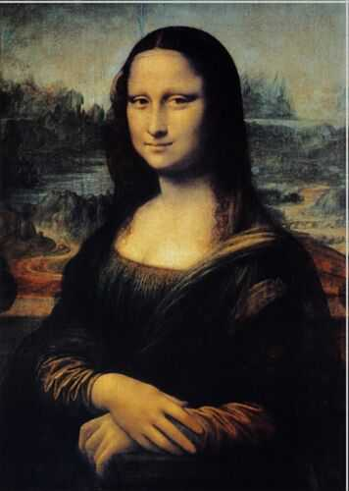
Mona Lisa

Slide 11
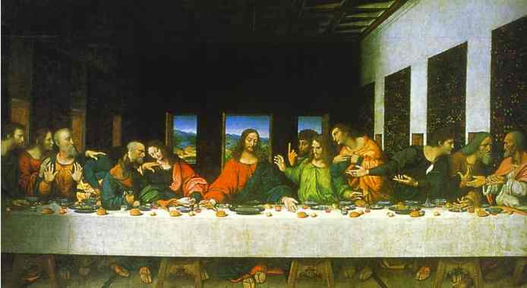
The Last Supper

Slide 12
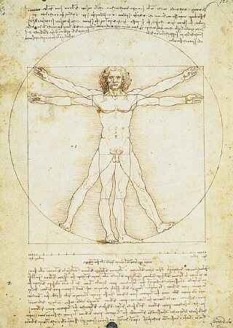
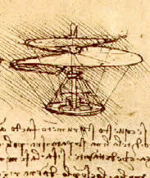
Scientific Achievements of da Vinci

Slide 13
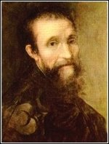
Michelangelo
greatest artists
of the period
excelled in architecture, art
and sculpture
Contemporary of da Vinci – they didn’t like each other….
Did a lot of work for the Pope (Catholic Church) and was commissioned by the very rich like the Medici’s

Slide 14
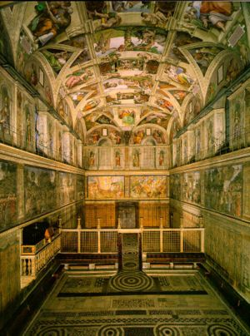
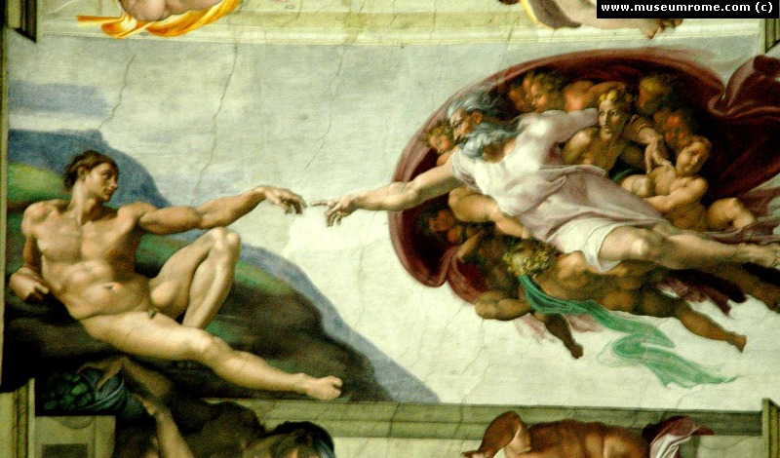
Michelangelo’s art
The Ceiling of the Sistene Chapel in Rome at the Vatican
God giving life to Adam

Slide 15
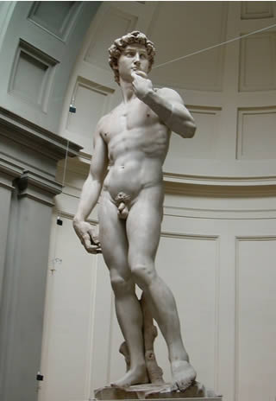
Also a sculptor…
David

Slide 16
HUMANISM – The work of…
Petrarch – father of humanism; a scholar and poet (wrote in Italian)
Famous work is called Laura
His work became a model for poetry

Slide 17
DANTE – medieval writer who wrote in the vernacular (Italian); wrote the Divine Comedy where he talks about his journey through hell, purgatory and paradise.
(the word "comedy", in the classical sense, refers to works which reflect belief in an ordered universe, in which events not only tended towards a happy or "amusing" ending, but an ending influenced by a Providential will that orders all things to an ultimate good)

Slide 18
Erasmus – humanist and priest; wrote in Latin
best-known work: The Praise of Folly, a satirical attack on the traditions of the Catholic Church and popular superstitions.
Wanted to reform the Catholic church and unlike his friend, Luther, committed to reforming the Church from within.
Philosophically opposite to Machiavelli

Slide 19
“CARD ME!” OUT-THE-DOOR LN QUIZ!
WHERE DOES THE RENAISSANCE BEGIN (YOU CAN GIVE ME THE CITY OR THE COUNTRY)
TUPAC CONSIDERED HIMSELF TO BE THE MODERN DAY ______ OF THE RENAISSANCE (DON’T WORRY ABOUT SPELLING HIS NAME RIGHT)
_________ WAS CONSIDERED TO BE THE PERFECT RENAISSANCE MAN.
MICHELANGELO IS FAMOUS FOR THIS WORK OF ART:
NAME ONE WORK OF CREATION OF DA VINCI

